Slide 1

CAPSTONE PROJECT
Production Management and Labor Organization System (PMLOS)
https://daihoc.fpt.edu.vn/

Slide 2







Supervisor
Mr. Tran Quy Ban
Contact: BanTQ3@fe.edu.vn
ABOUT TEAM
Phan Duy Vy
SE04580
Nguyen Dinh Hoang
SE05011
Giap Minh Luat
SE04780
Leader
Member
Member
Vu Ngoc Thuong
SE04786
Nguyen Thi Huong
SE04846
Member
Member

Slide 3
Introduce about
"Quang Hanh" company
01
05
Project requirements
02
Table of contents
06
Project overview
Design
03
07
System building ideas
Testing
04
08
Project management
Demo & QA

Slide 4

1. INTRODUCTION ABOUT QUANG HANH COMPANY
A
About company
B
Organizational structure

Slide 5
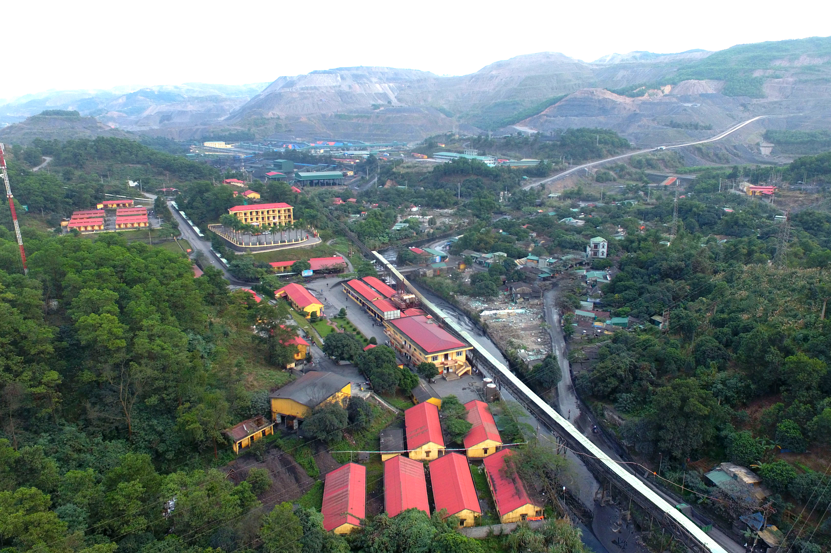
A. About company
Get a modern PowerPoint Presentation that is beautifully designed.
Address: 302 Tran Phu Street, Cam Thanh Ward, Cam Pha City, Quang Ninh Province.

Slide 6
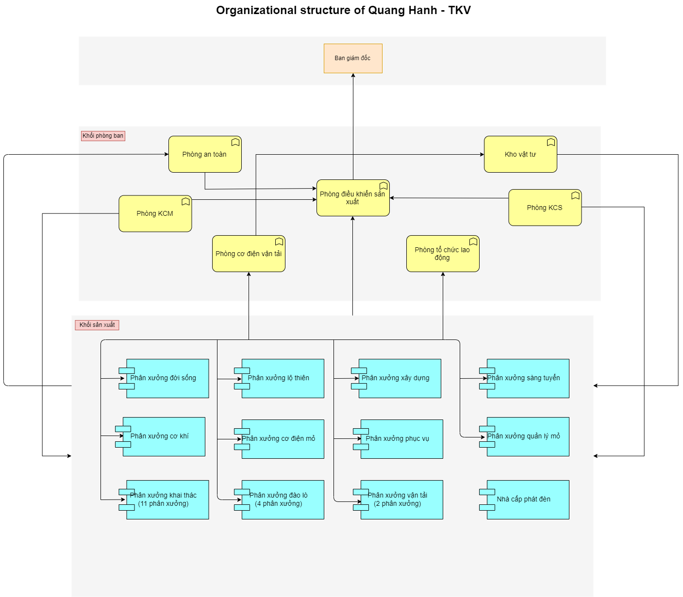
B. Organizational structure
You can simply impress your audience and add a unique zing and appeal to your Presentations. Get a modern PowerPoint Presentation that is beautifully designed. I hope and I believe that this Template will your Time, Money and Reputation.

Slide 7
2. Project overview
2.1. Current system
Recruitment
Changing employee information
Payroll calculation
Track meals
Directing employees
Contract Termination
Certificate management
Company-wide list
Safety department

Slide 8

2.2. Exist system
2.3. Conflict
Attendance software
Dispatch management software
Supplies management software.
Workshop - Labor Organization
Departments Workshops - Living room
Central - Labor Organization - Director - Labor Organization - Workshop
Staff - Labor Organization - Director - Labor Organization – Workshop
Staff - Labor Organization
Workshop - Production control - Labor safety room - Labor organization

Slide 9
3. System building ideas
This will be an intuitive, comprehensive management system, help the management becomes
Faster
Multitasking,
Simpler,
More efficient,
Eliminating the limitations of the system manual
Improve production efficiency
Minimize the risk of error.
About system
For paperwork managers
For the company's certificate and employee’s certificate manager
For managers who mobilize employees
For labor productivity managers.
About functional

Slide 10
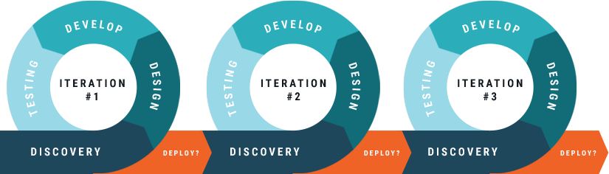
4. Software management
Software process model

Slide 11
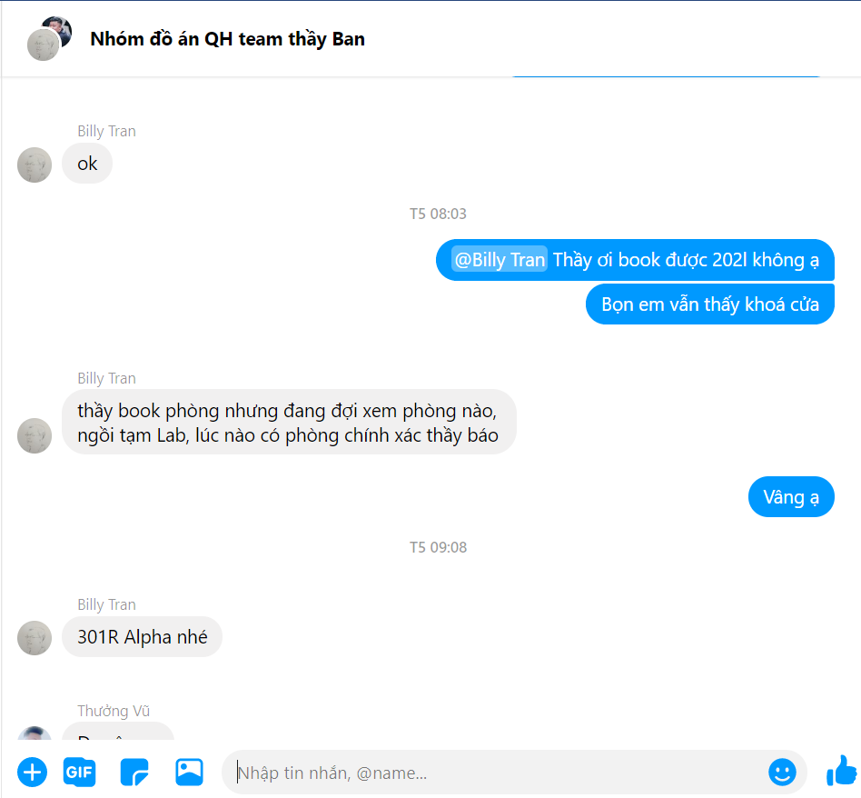
Communication plan
Meeting with supervisor
Meeting with team member
The meeting is not regulated

Slide 12








Project tool

Slide 13
No | Risk | Description | Category | Root Cause | Contingency Plan | Probability | Impact
1 | Conflicts among member | Lost solidarity in the team | People | Conflict in each members opinion, conflict before | Project manager have to resolve that problem, make a meeting or voting to unify opinions | Medium | High
2 | Absence of team member | Team members are sick, busy can not complete task | People | Personal reasons | Share the task of absence for member | Medium | Medium
3 | Late deadline | Team members don't meet the deadline | People | Team member not hardworking, don’t follow the deadline | Member must report everyday, every step to PM. So that PM can control the project process | Medium | Medium
4 | Losing data | Error occurred causing loss data | Process | Equipment is broken, server is down | Make backup data or clone version | Low | Medium
5 | Change requirement | The requirements and scope are changed | Process | Custommer want to change requirement | Report to supervisor to change document and plan again | Medium | High
6 | Team member doesn't clear the requirement | Team member doesn't clear the requirement | Process | Project team member misunderstands requirement | Confirm requirement with teamlead and read requirement clearly | Medium | Medium
7 | Exchange technology | Change layer code | Technology | Team chose wrong layout code for project | Team member have to work overtime to meet deadline | Medium | High
Risk

Slide 14


5. Software requirement
5.1. User requirement specification include 3 main parts
Employee management: Includes functions that allow users to manage employees profile, recruitment, directing people, certification in company …
Report: report about salary, employee quantity in departments …
System management: this part providing for administrator to perform system management tasks such as config, delegation, resource management.

Slide 15
5.2. System requirment

Slide 16
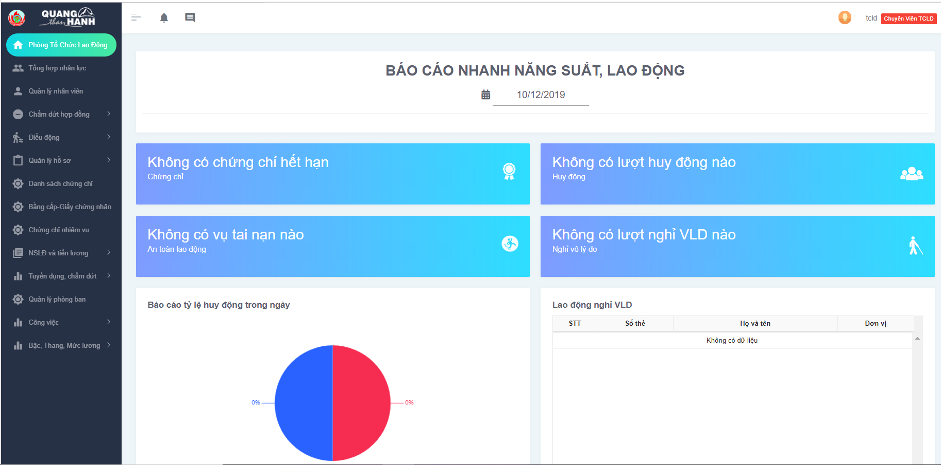
DashBoard

Slide 17
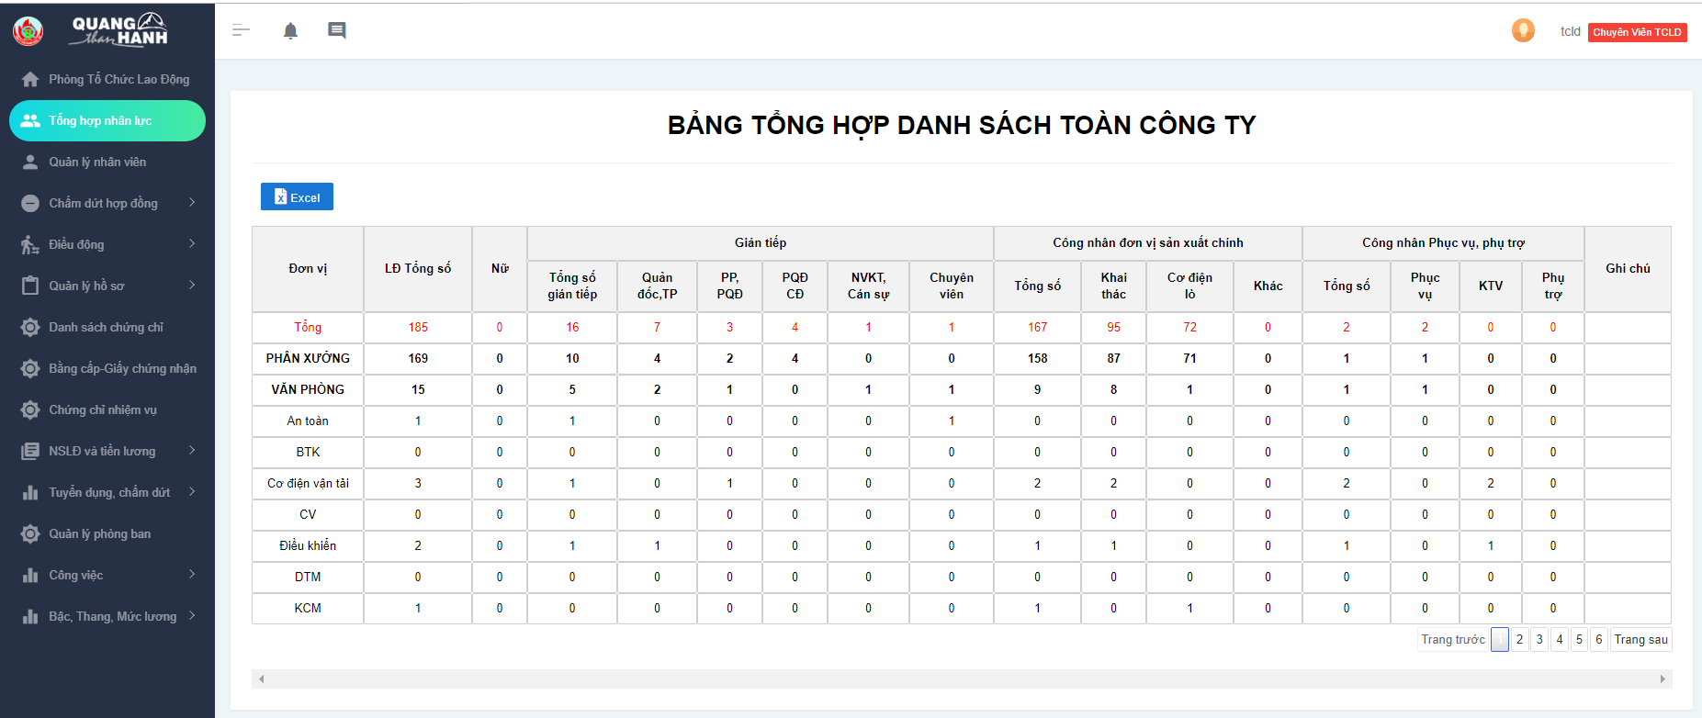
Synthesis of manpower

Slide 18
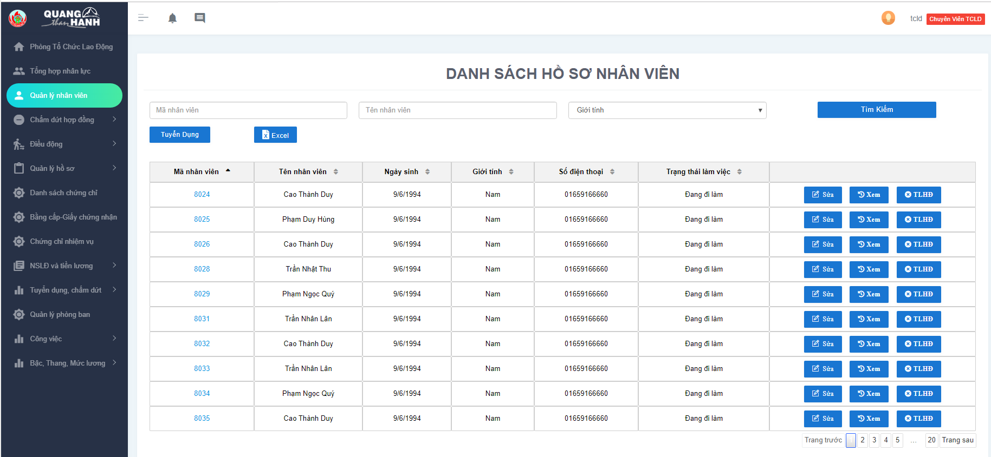
Employee manager

Slide 19
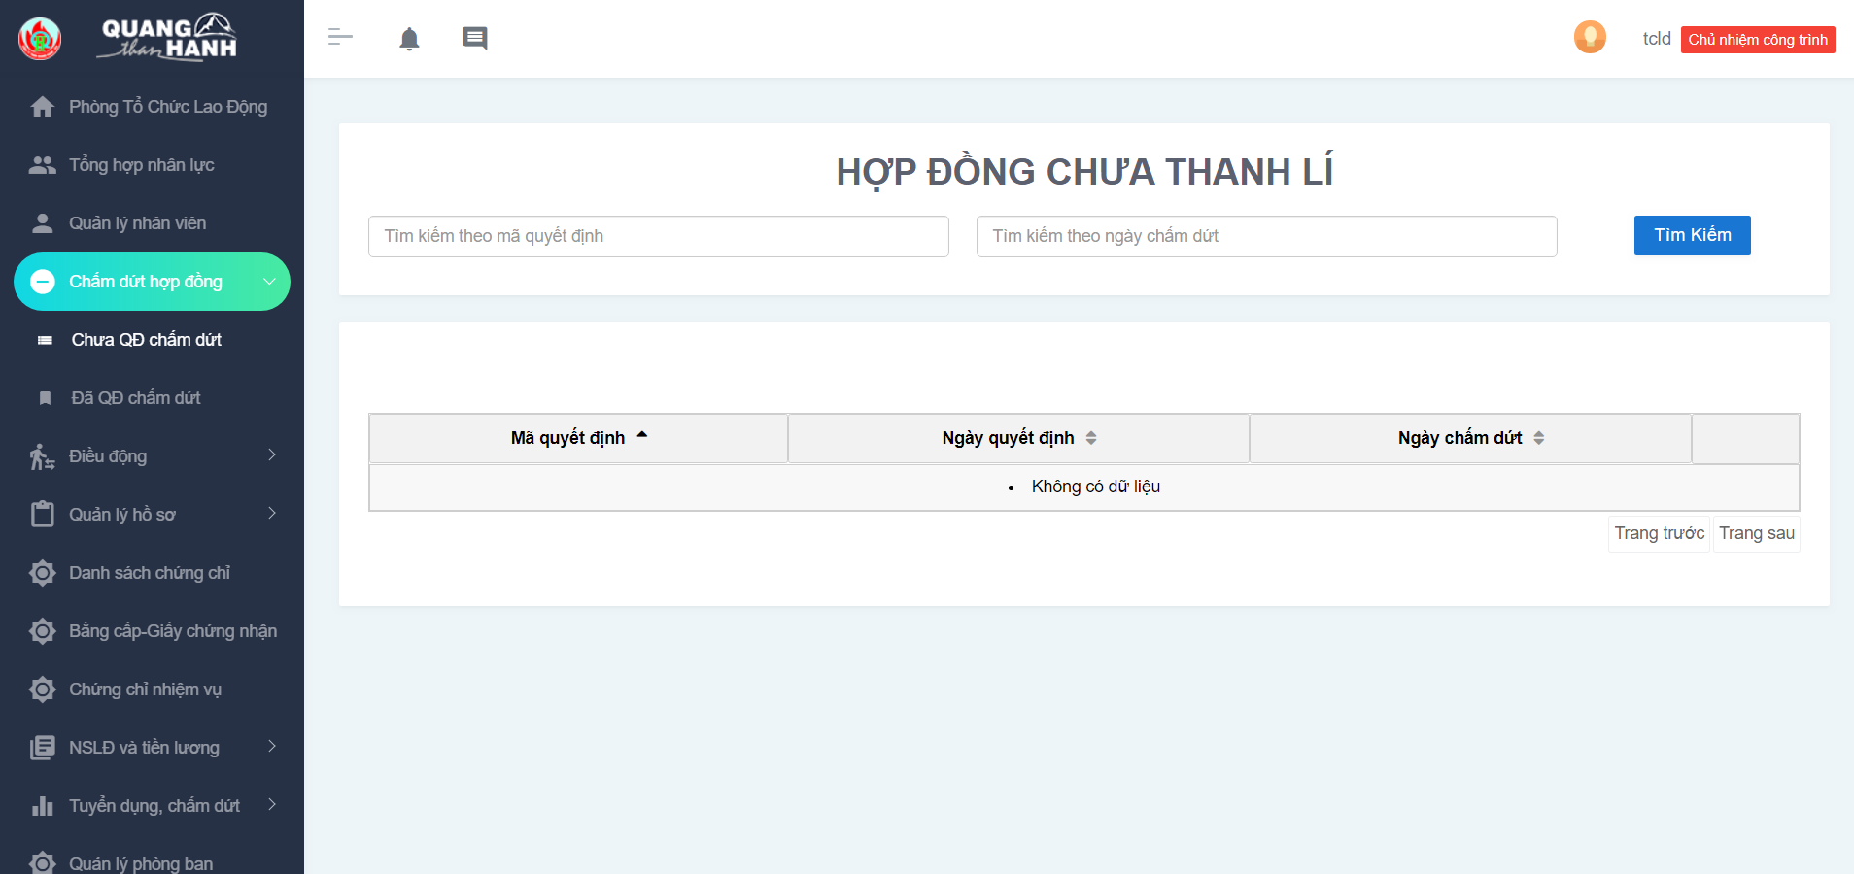
Termination undecided

Slide 20
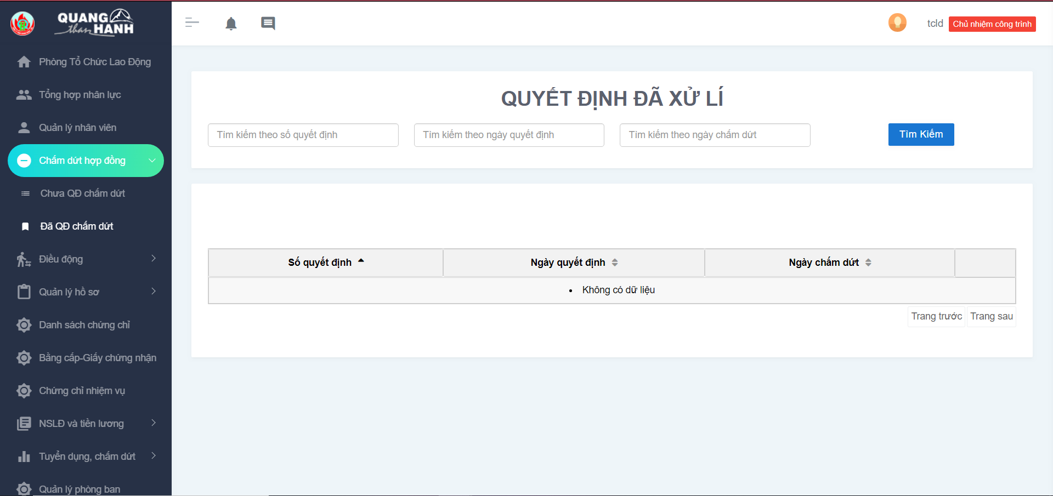
The decision has been processed

Slide 21
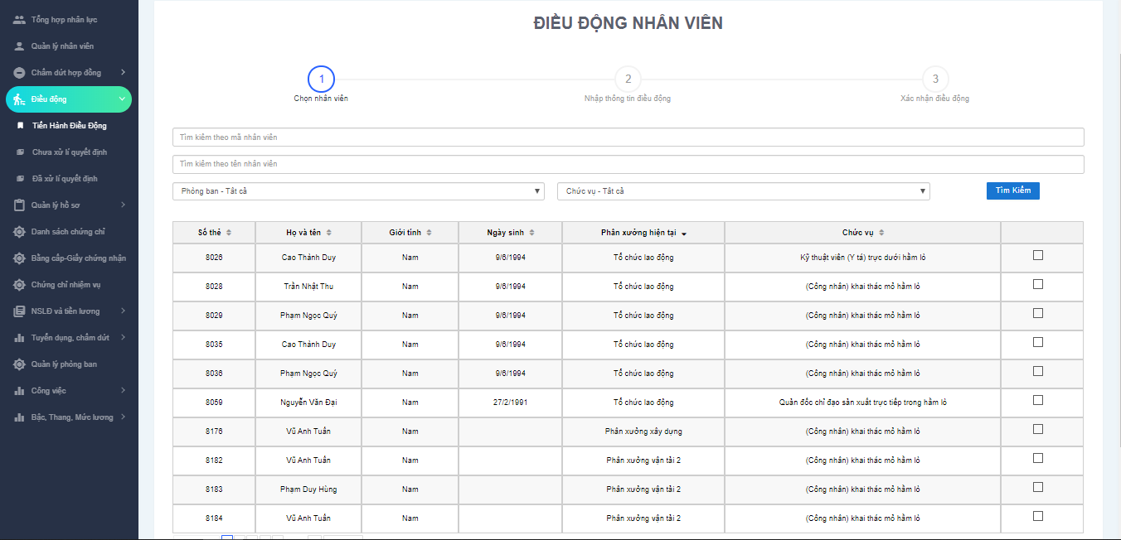
Conduct maneuvers

Slide 22
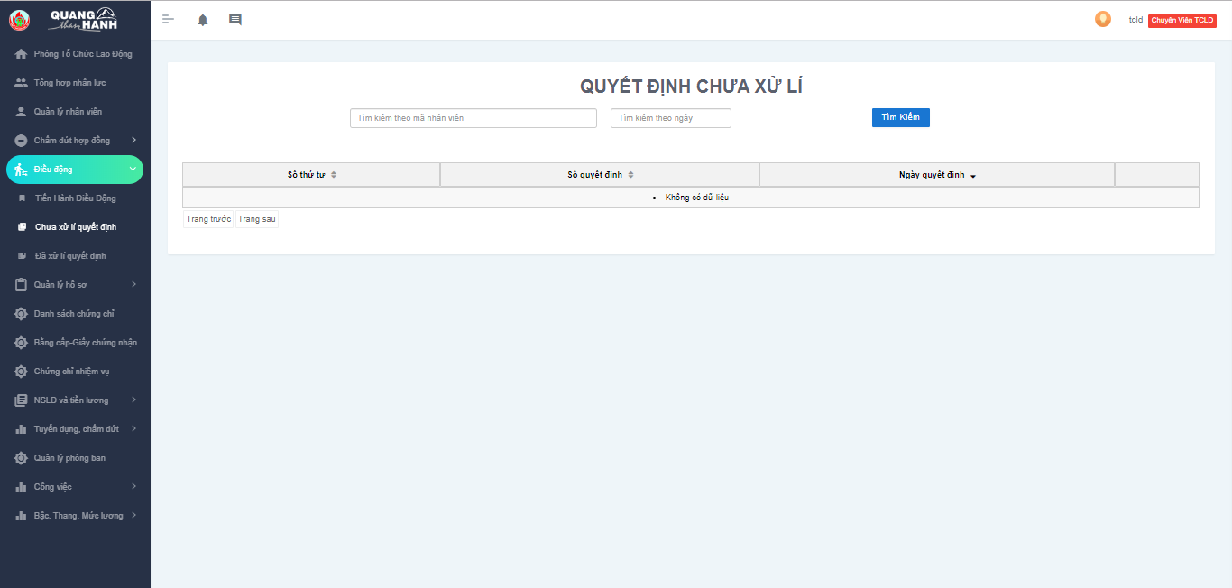
Pending decision

Slide 23
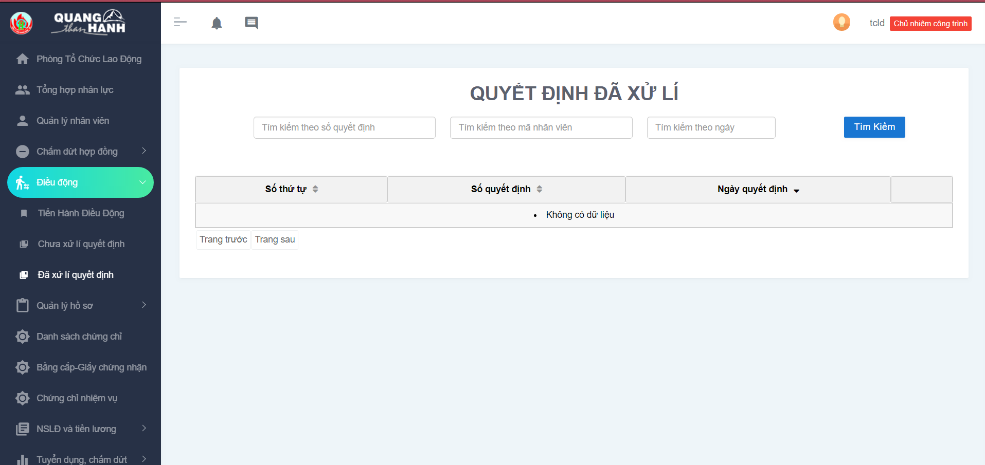
Decision processed.

Slide 24
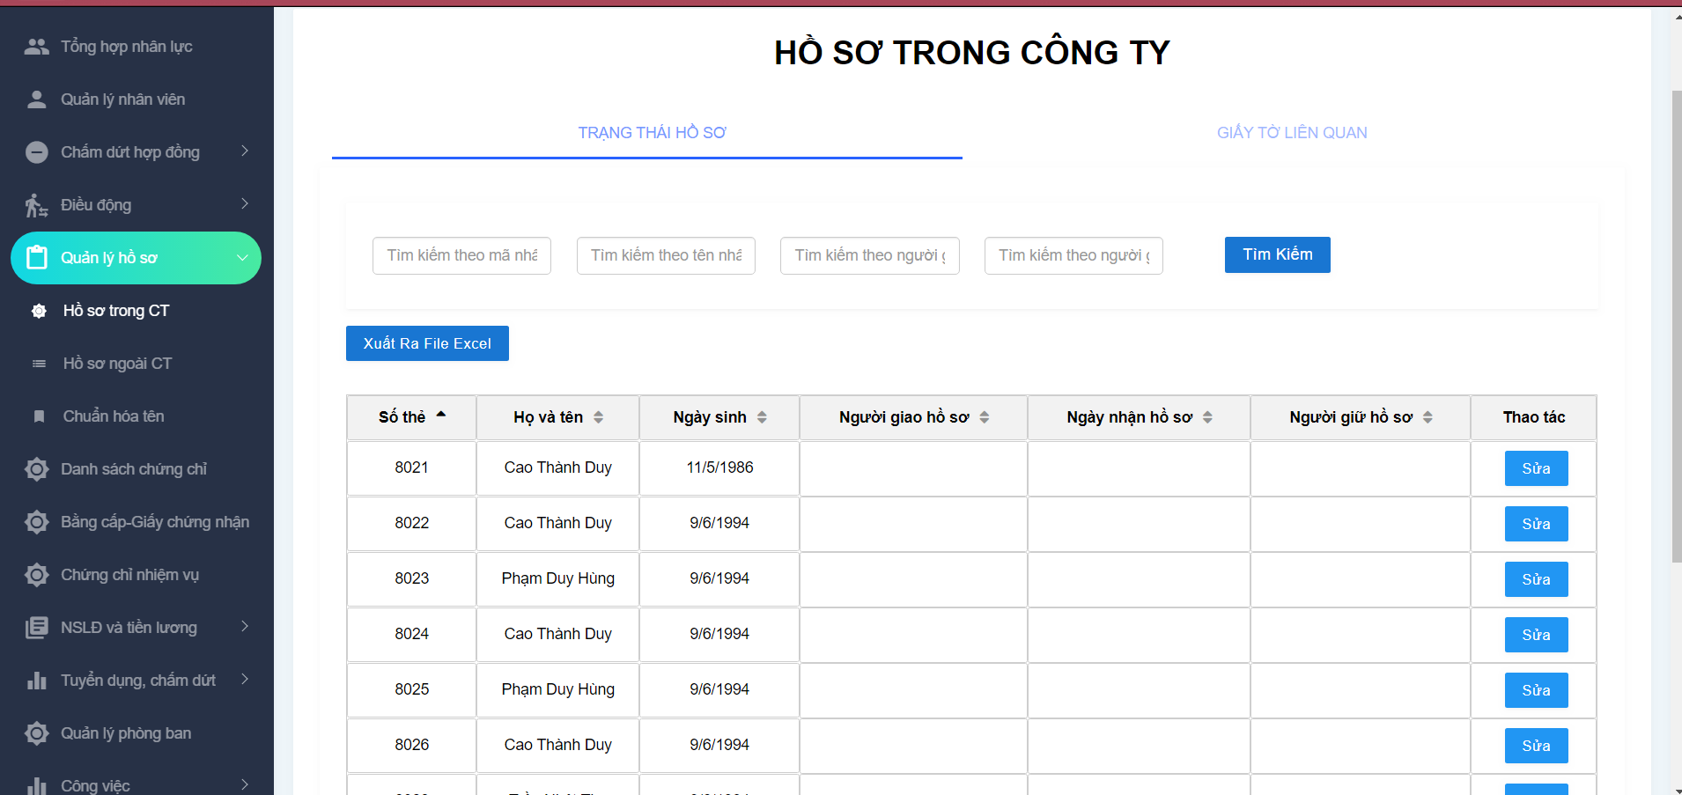
Profile in the company

Slide 25
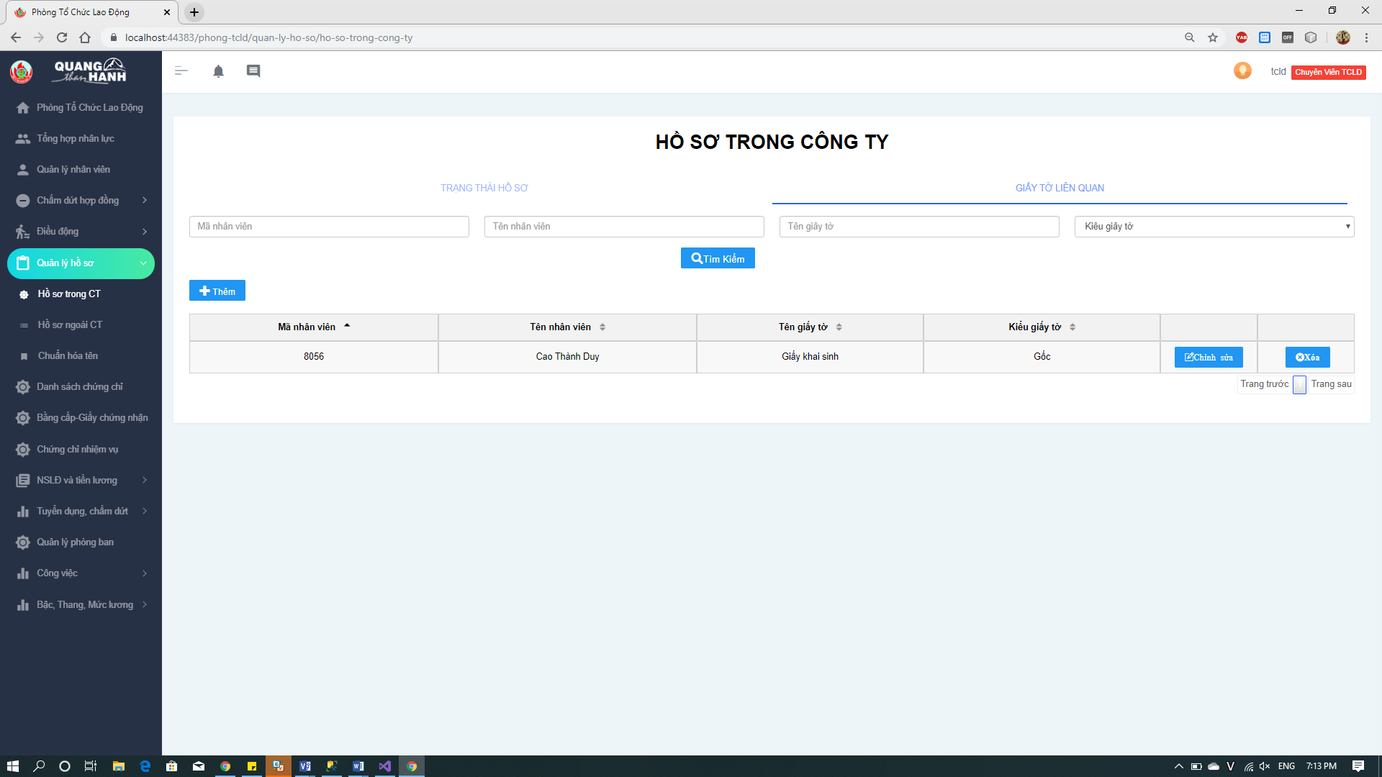
Documents

Slide 26
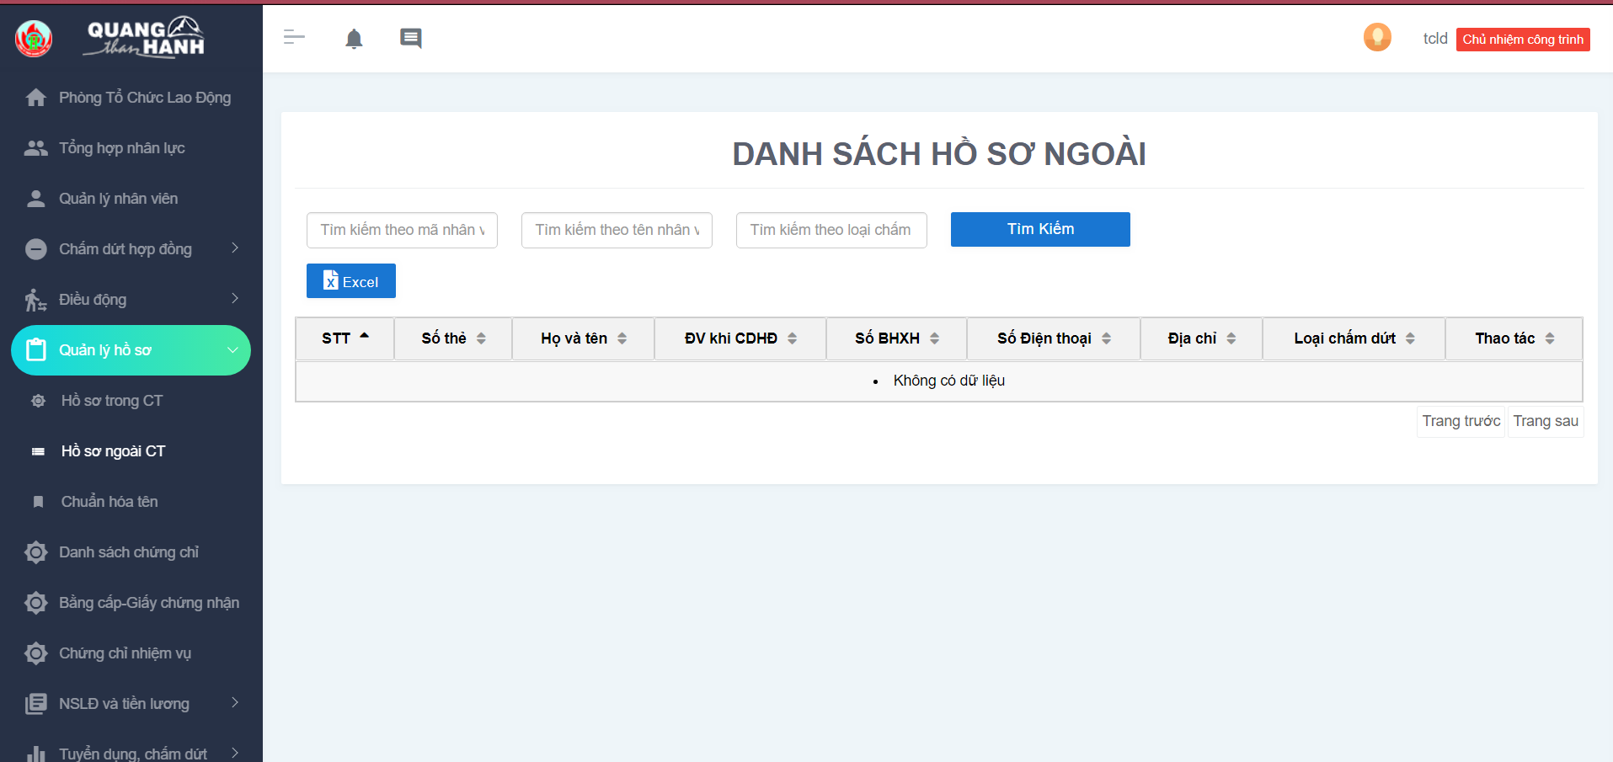
Profile outside the company

Slide 27
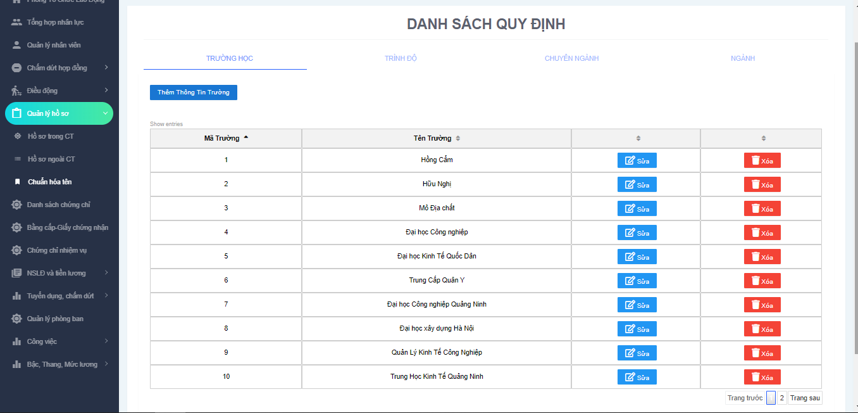
School

Slide 28
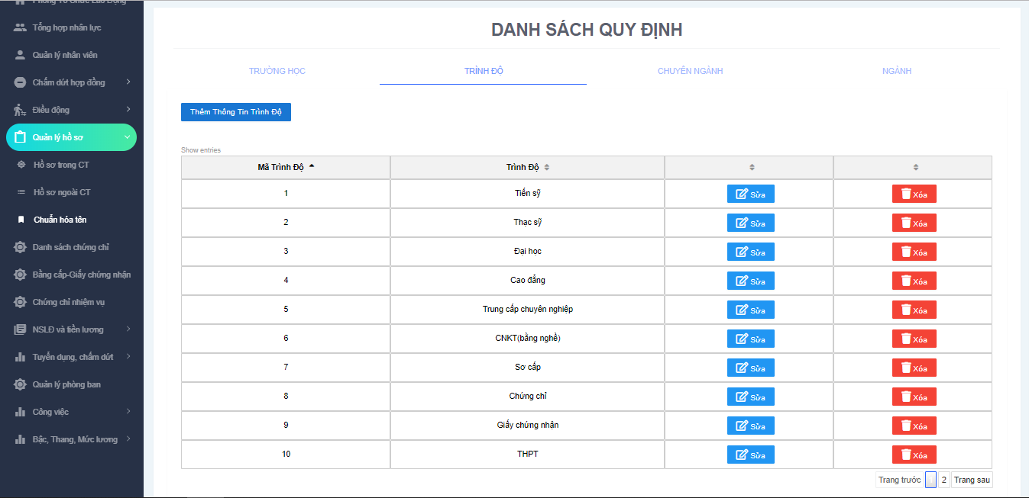
Degree

Slide 29
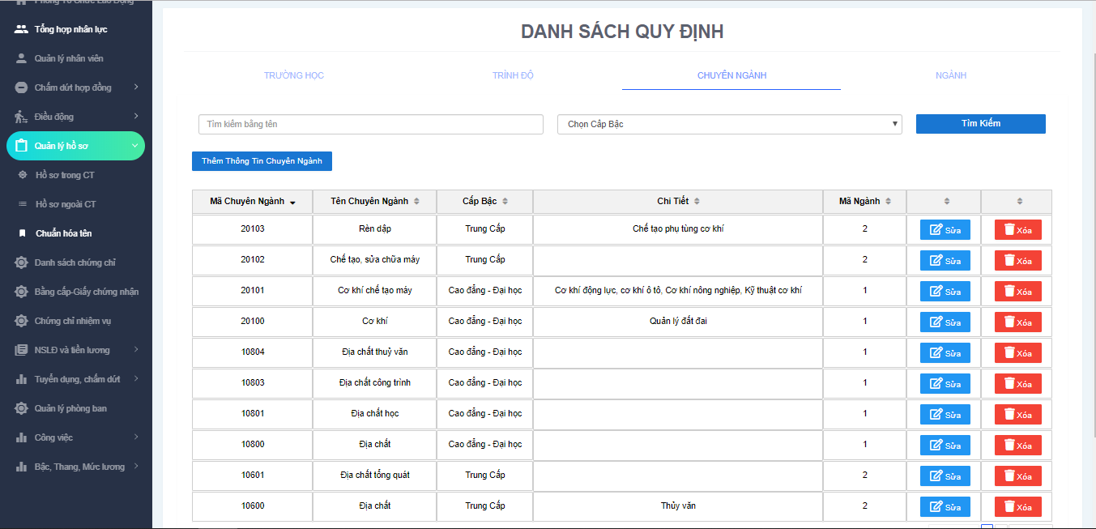
Major

Slide 30
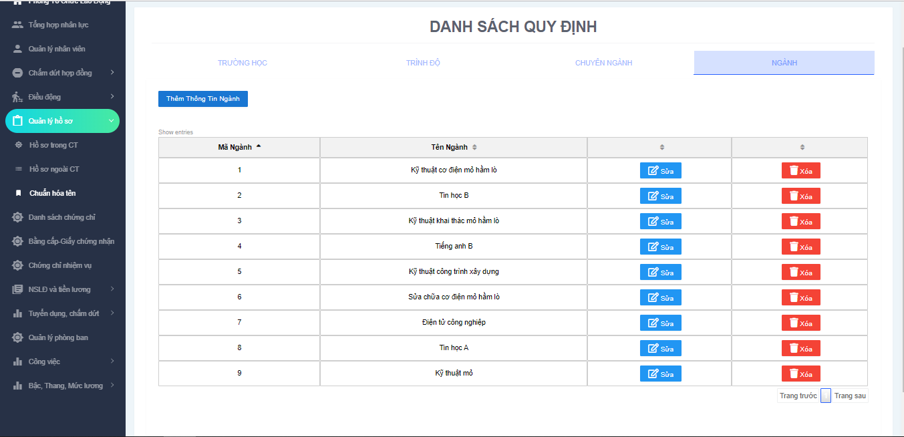
Industry

Slide 31
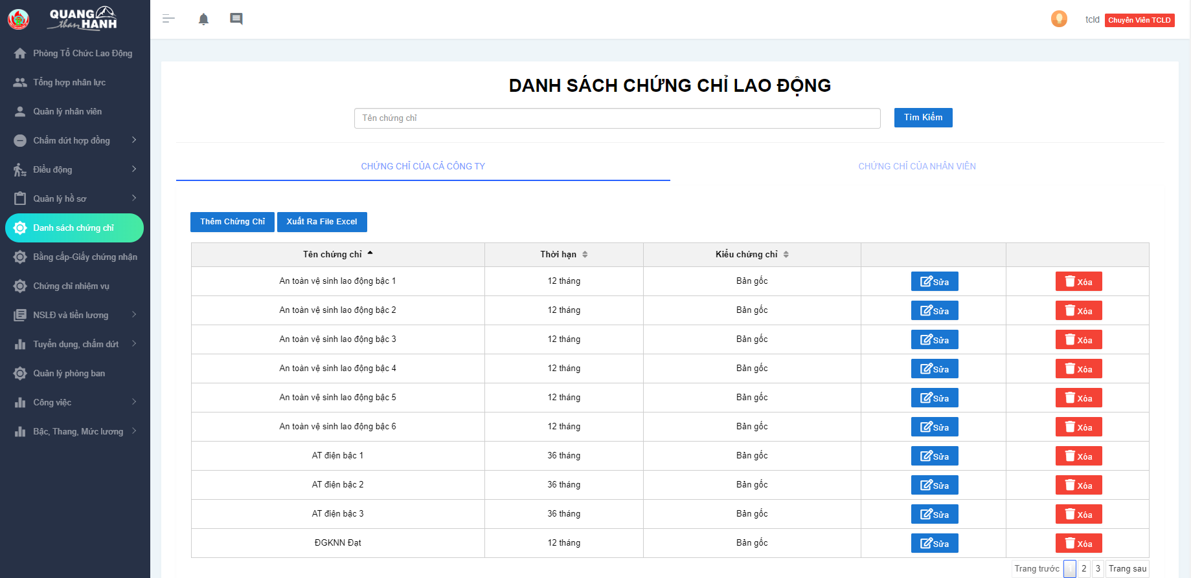
Certificate of company

Slide 32
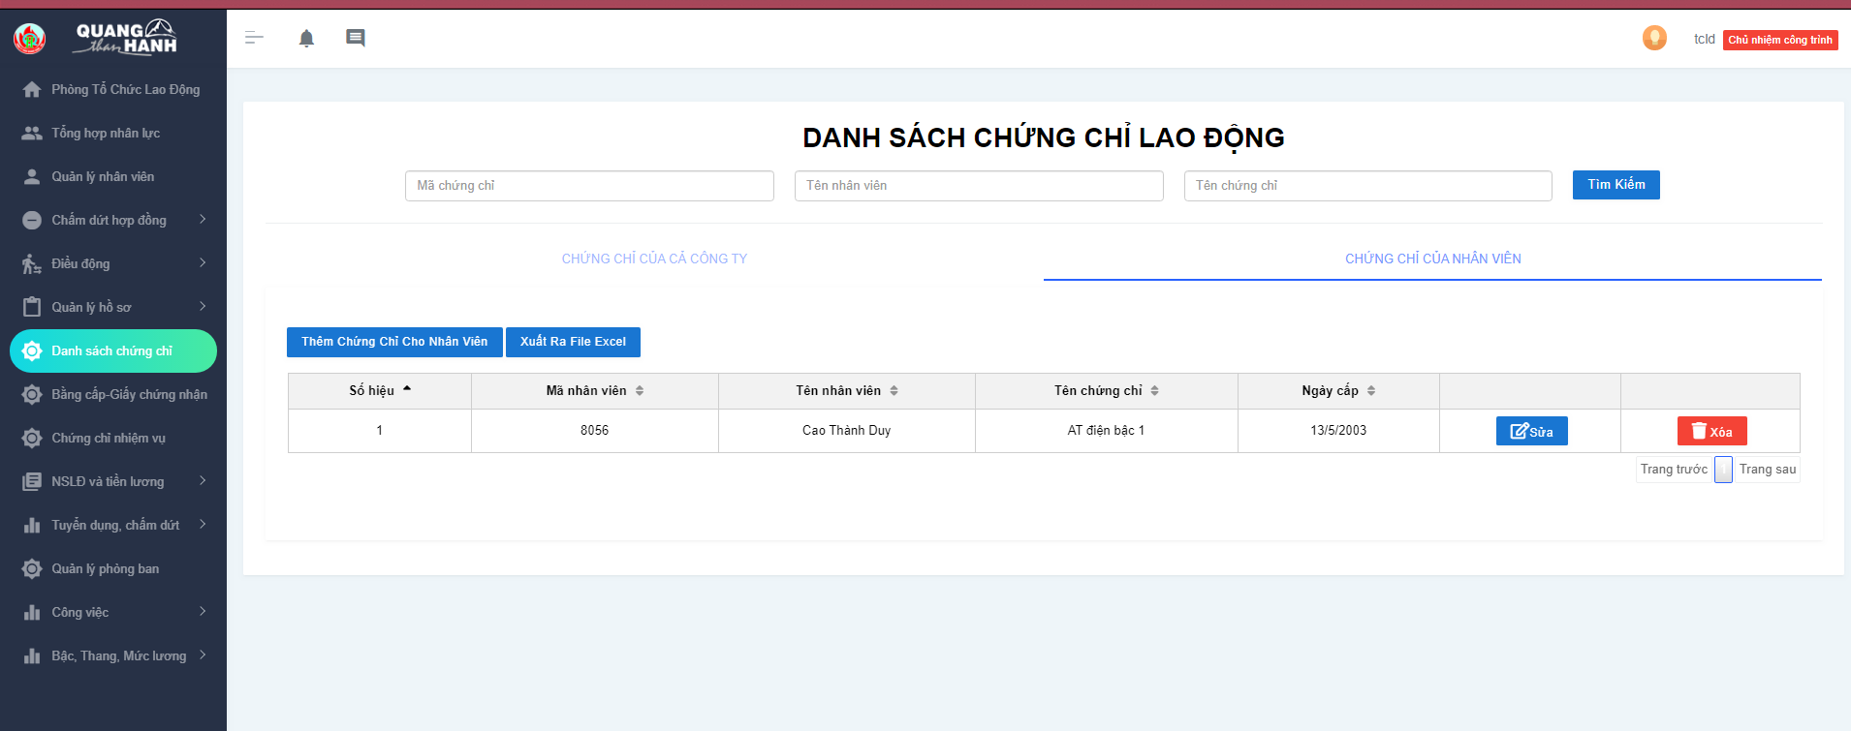
Certificate of employee

Slide 33
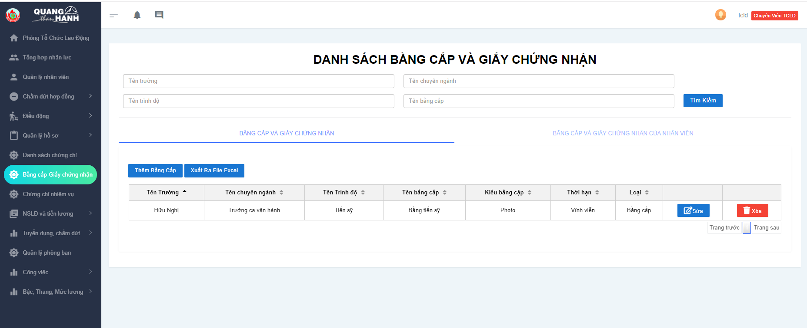
Diploma

Slide 34
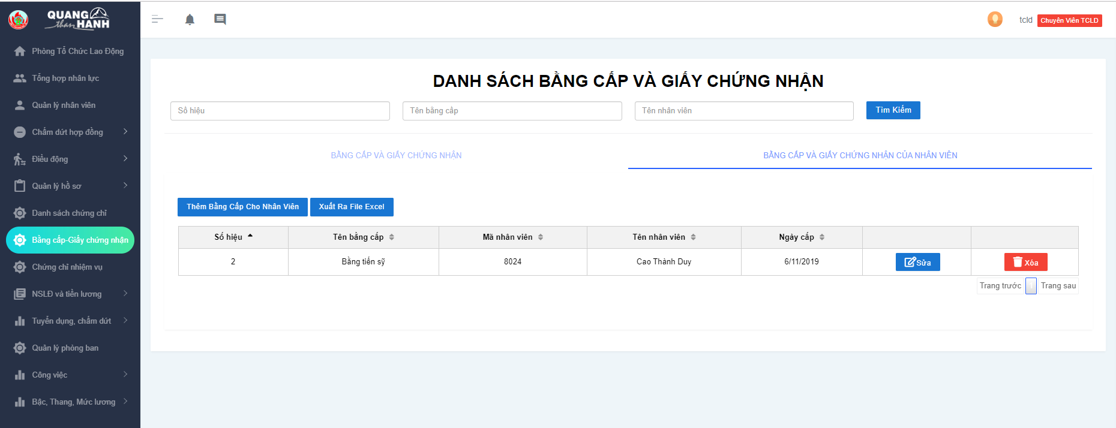
Diploma of employee

Slide 35
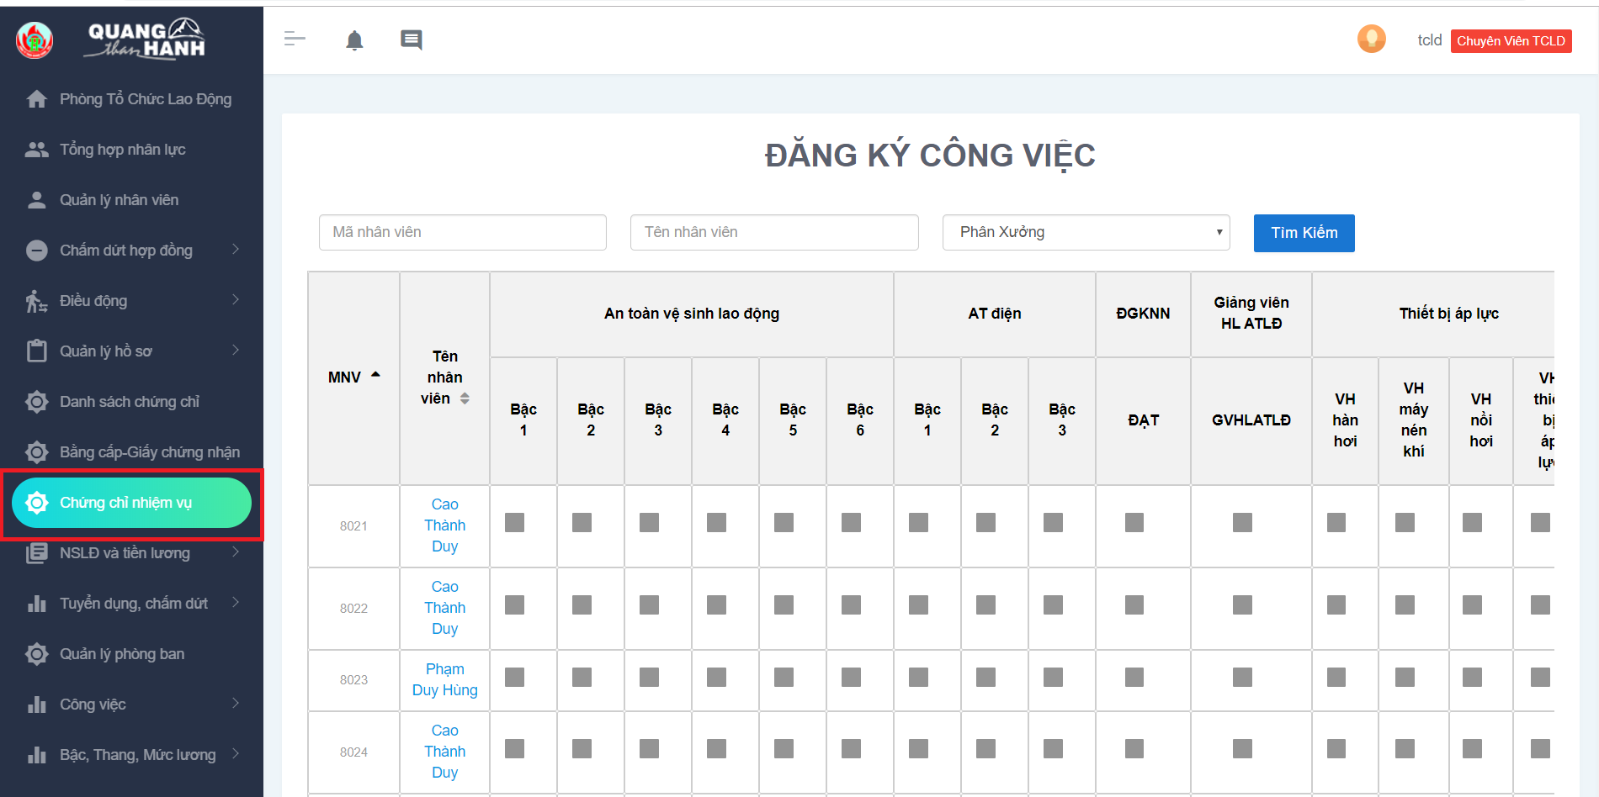
Certificate of duty

Slide 36
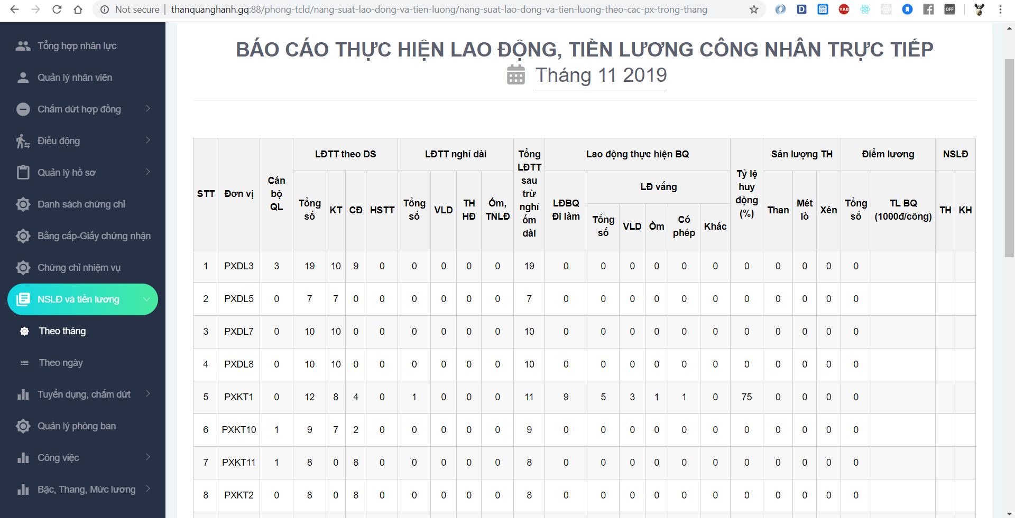
Labor productivity and wages by month

Slide 37
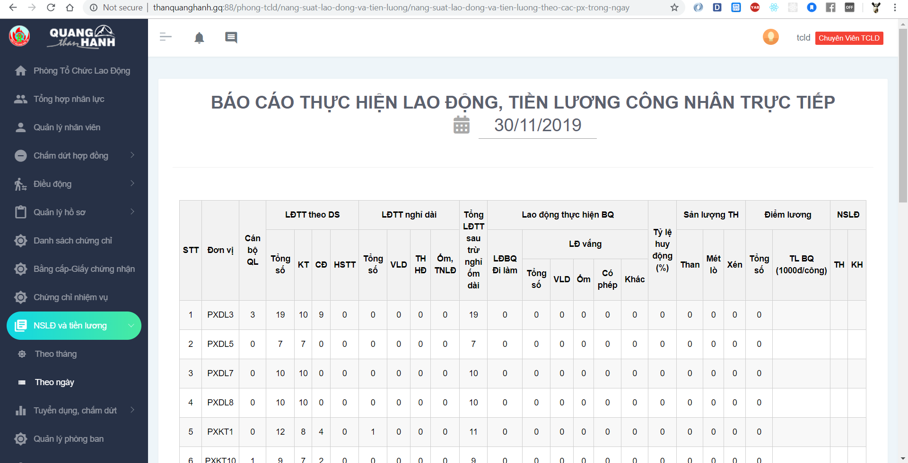
Labor productivity and wages by day

Slide 38
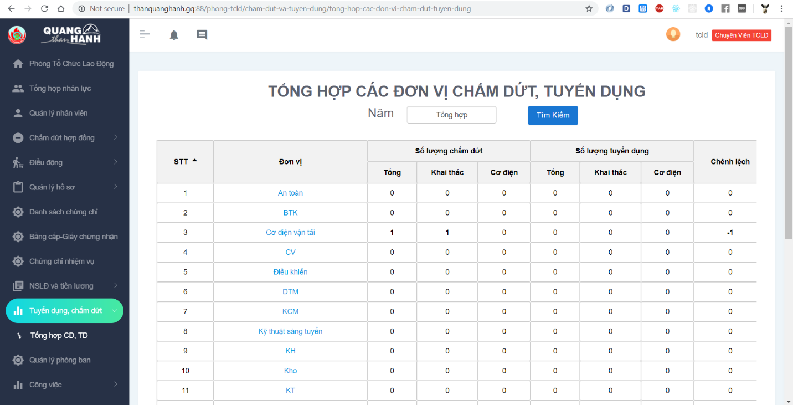
Recruitment, termination

Slide 39
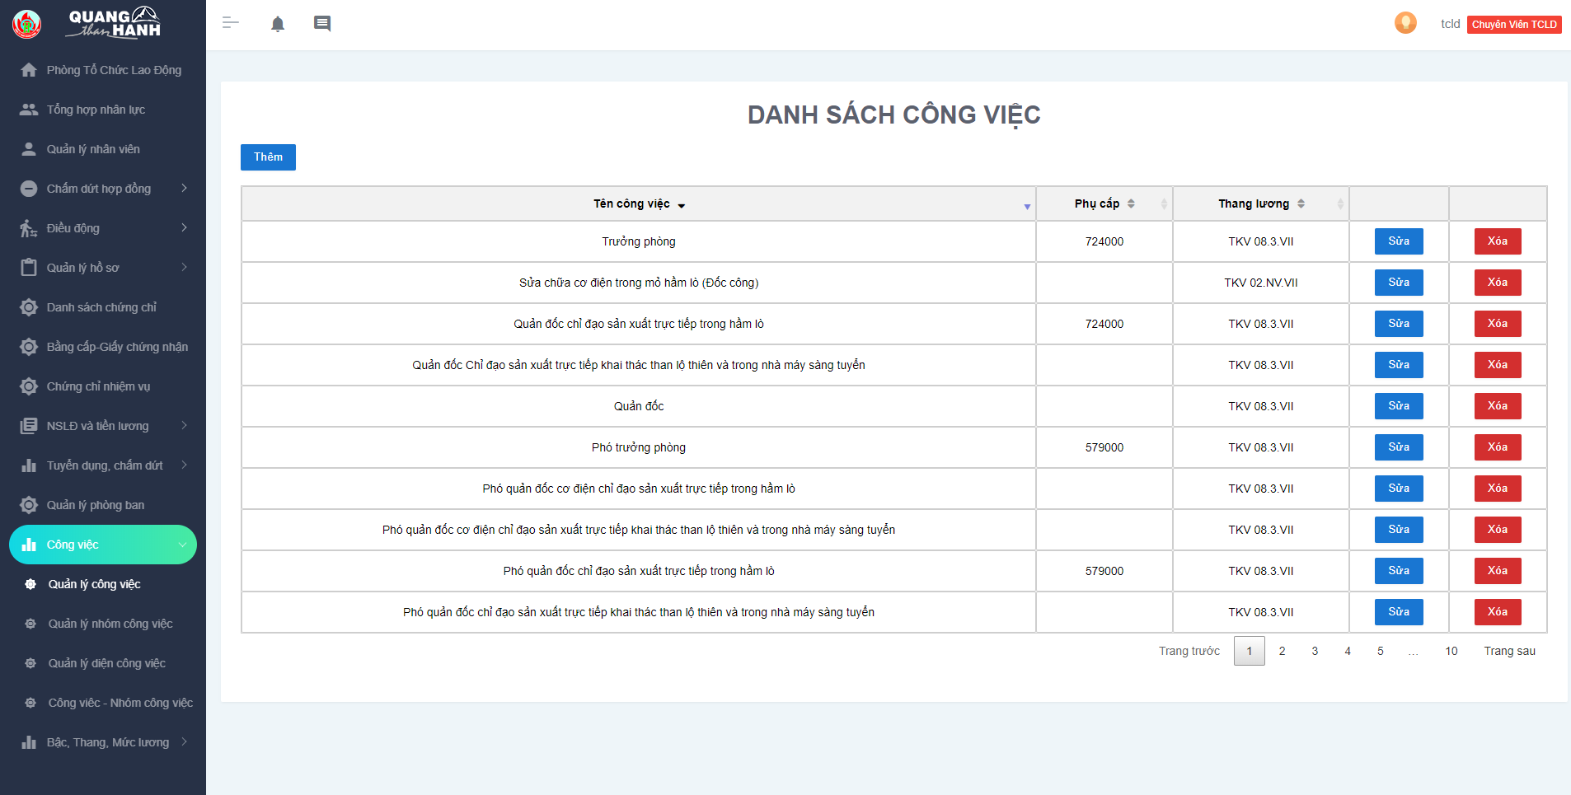
Workflow management

Slide 40
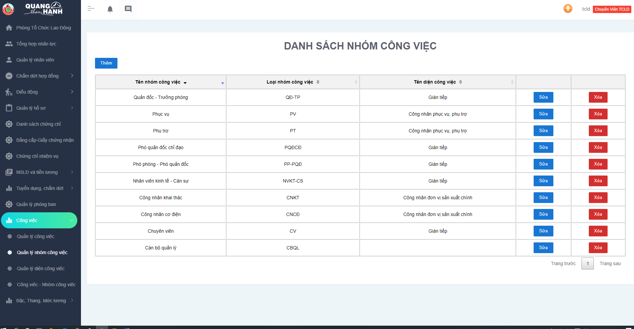
Workgroup management

Slide 41
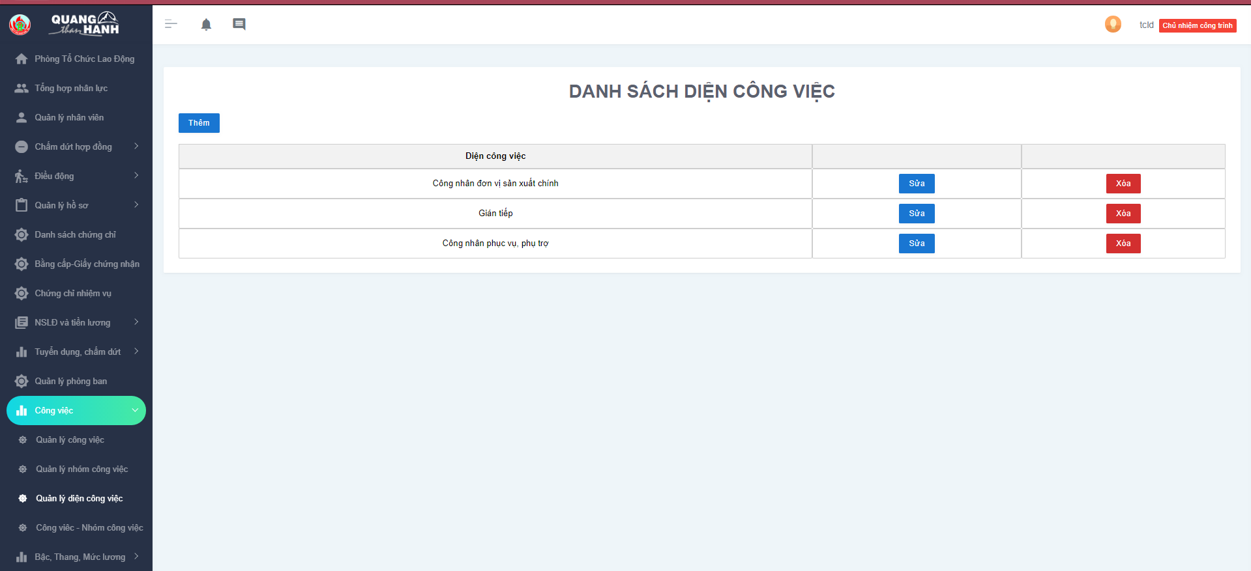
Side of job

Slide 42
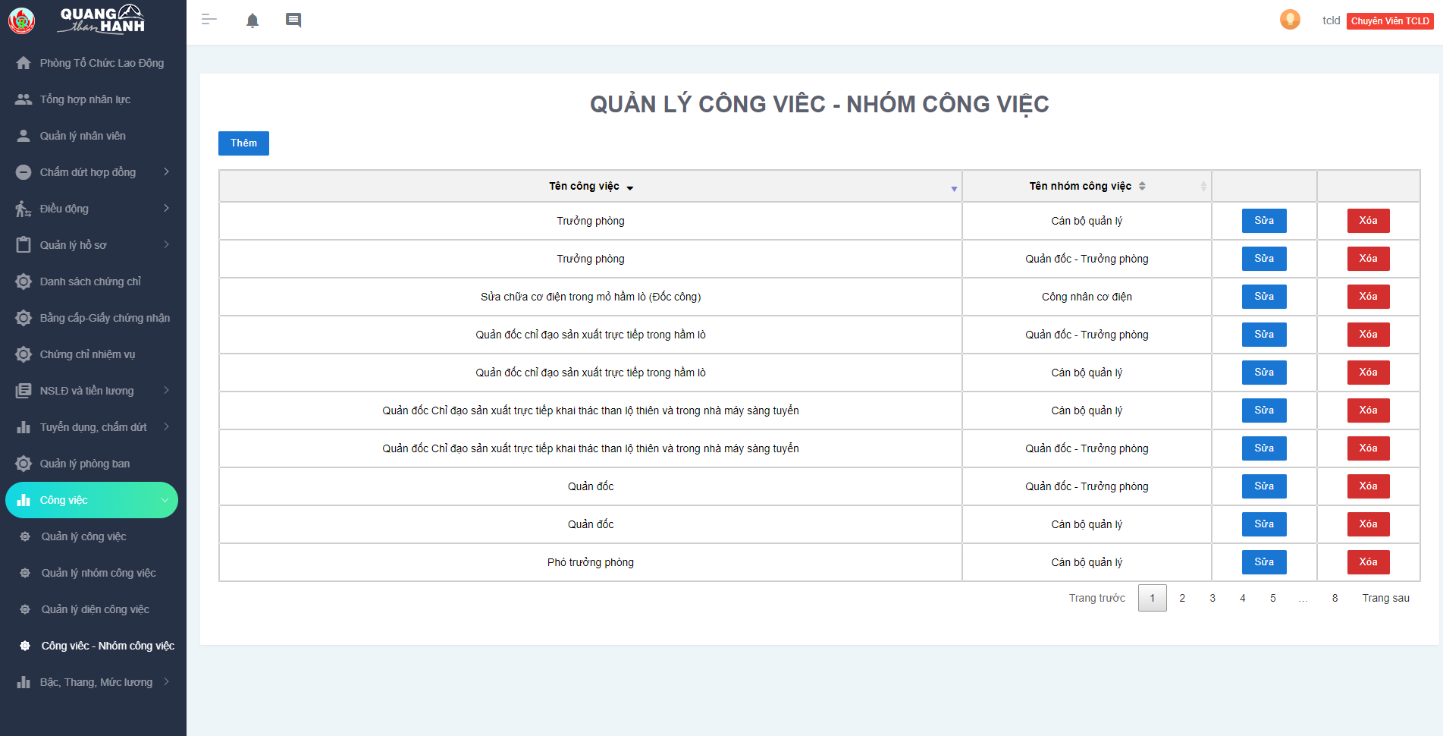
Jobs - Workgroups

Slide 43
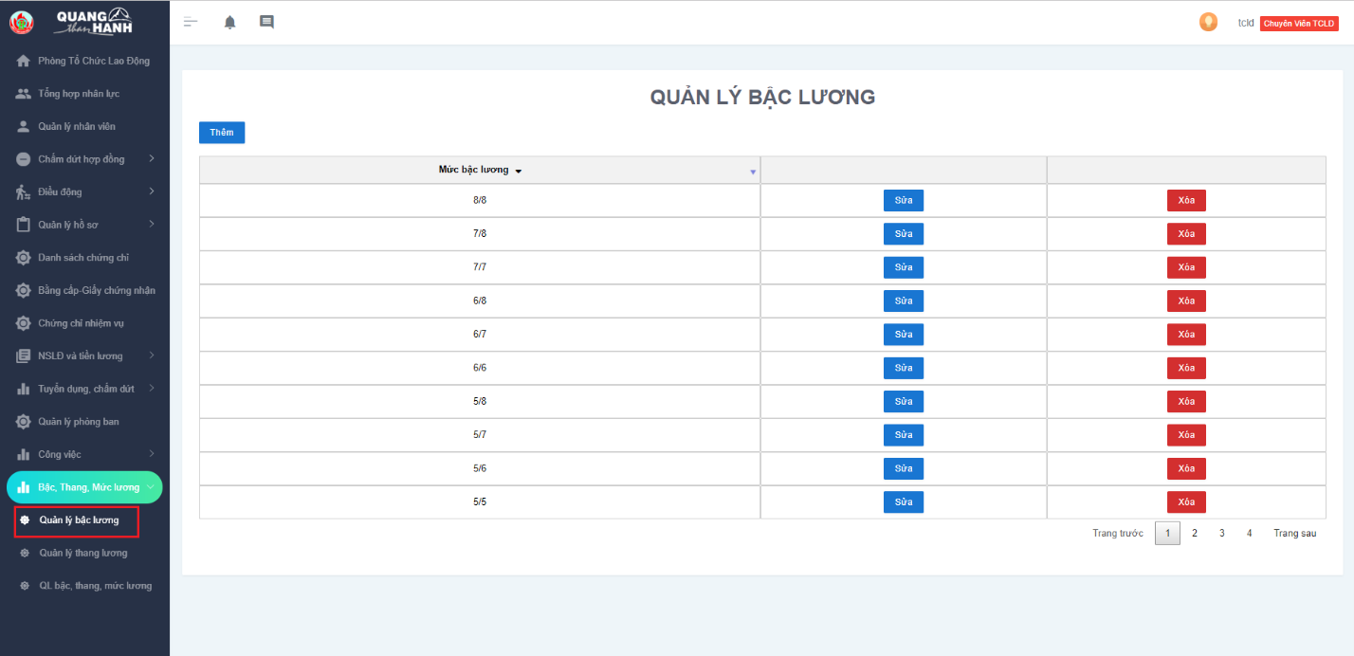
Salary grade management

Slide 44
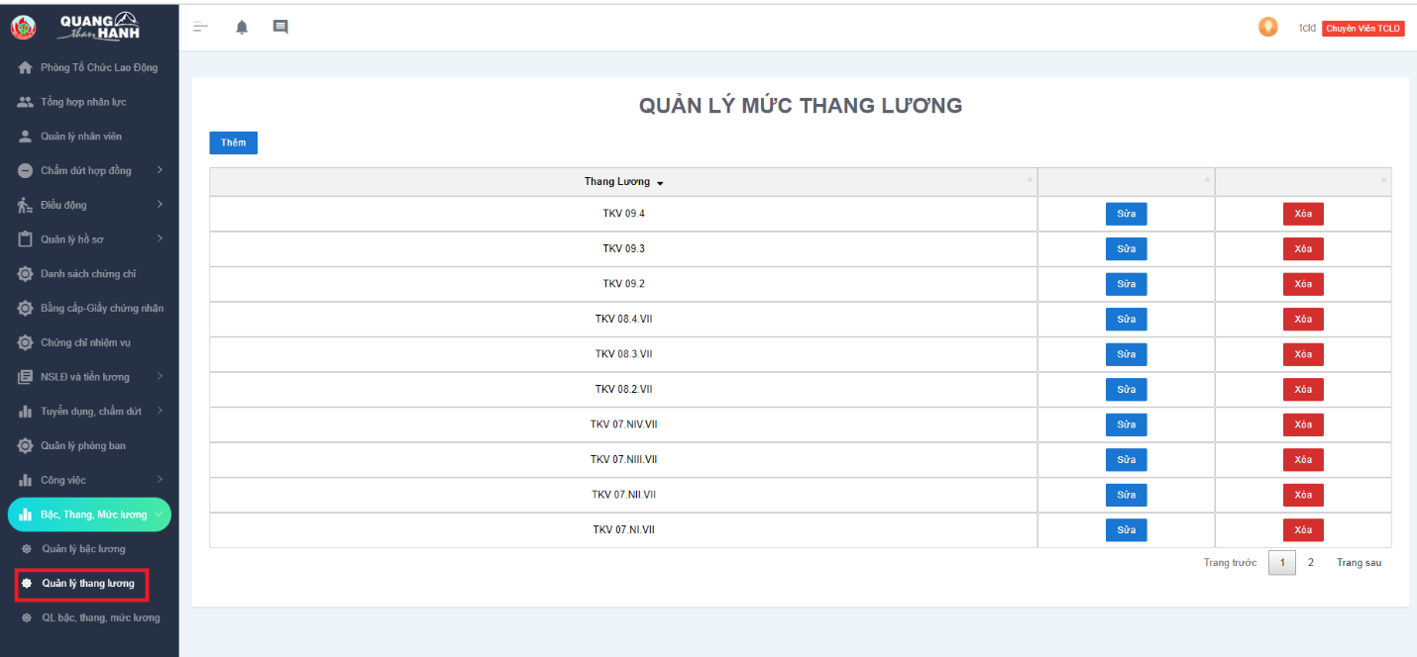
Salary scale management

Slide 45
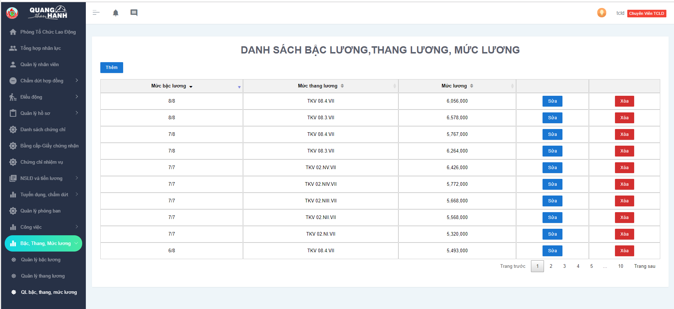
Manage Salary grade, salary scale, salary level

Slide 46
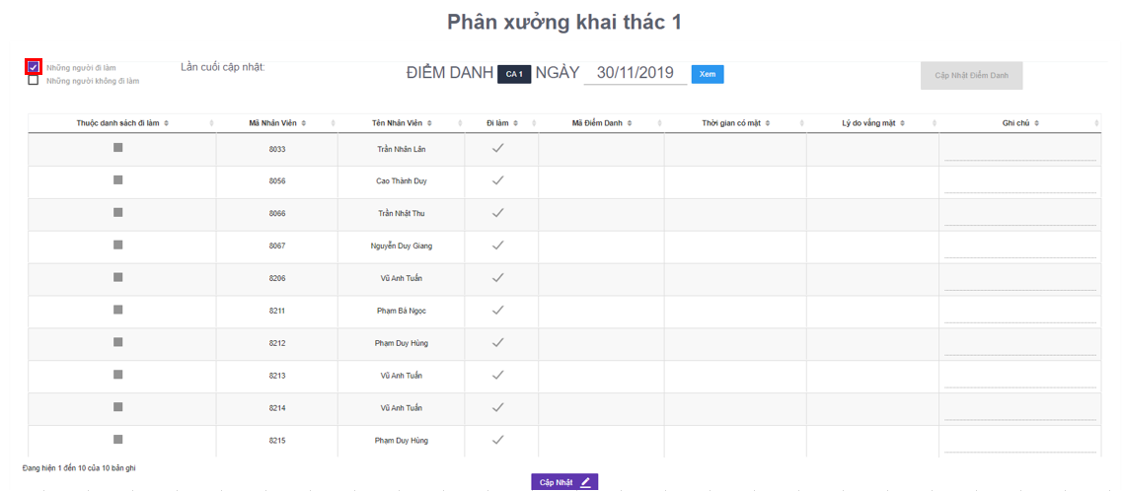
Attendance

Slide 47
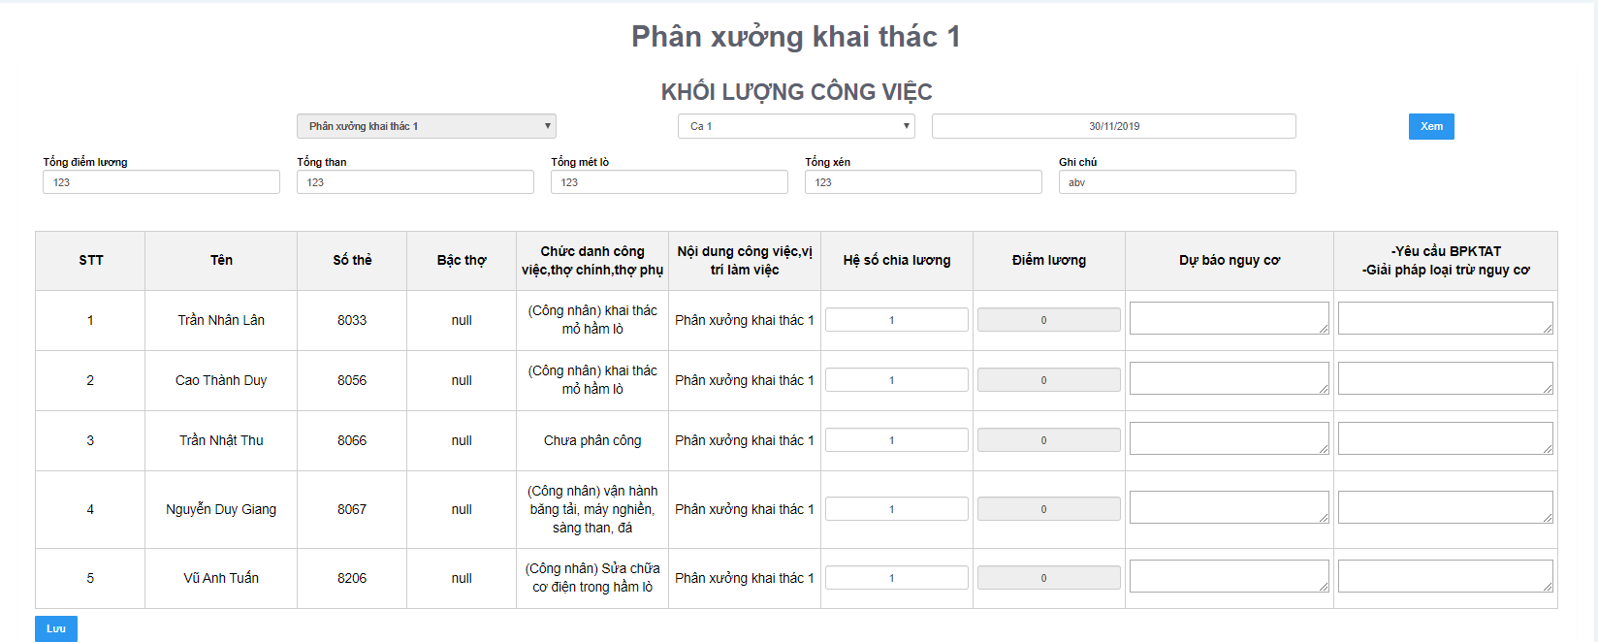
Enter labor productivity and wages

Slide 48
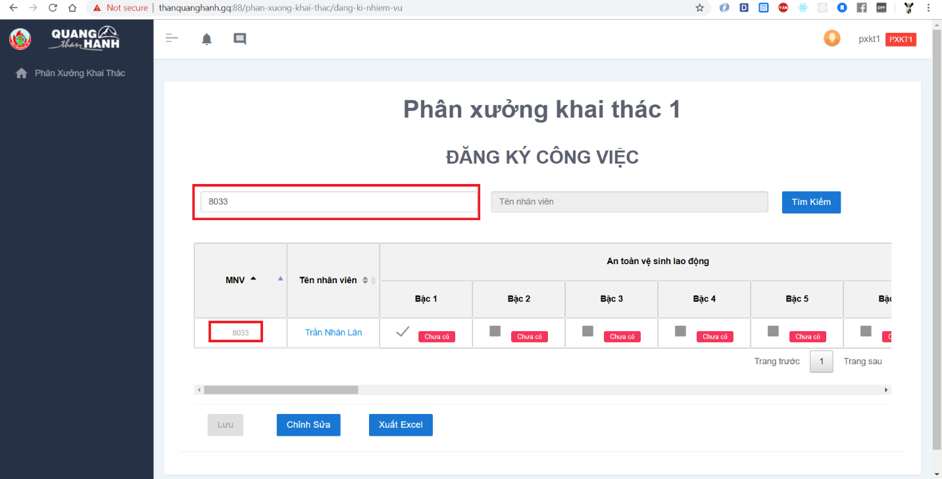
Register the mission

Slide 49
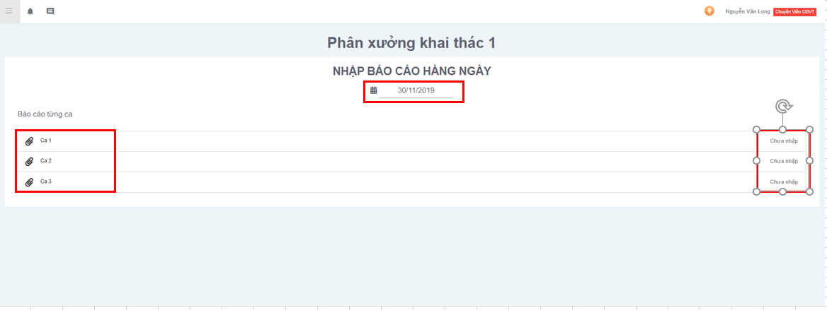
Send report to control room

Slide 50
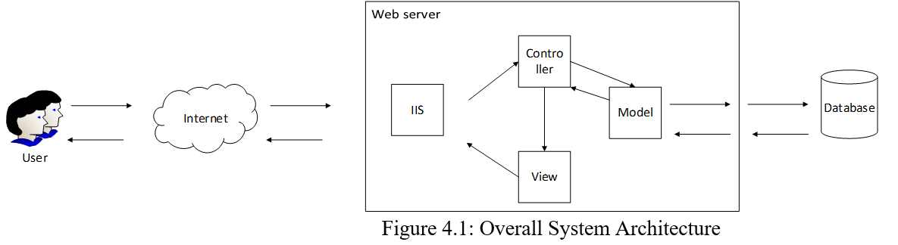
6. Design
- Overall System Architectural

Slide 51
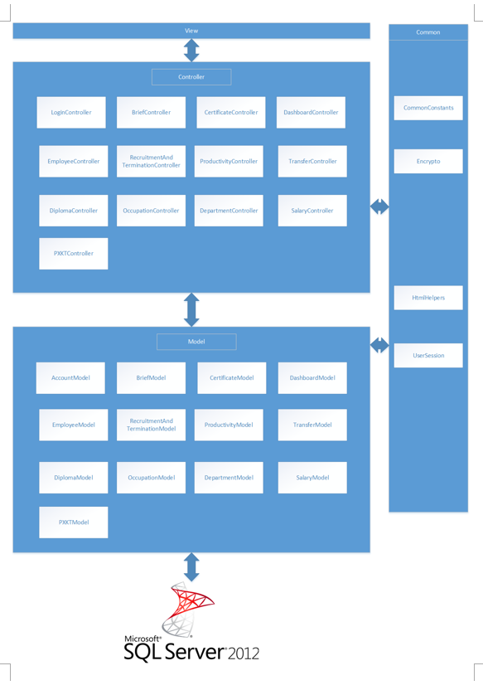
- System layer design

Slide 52
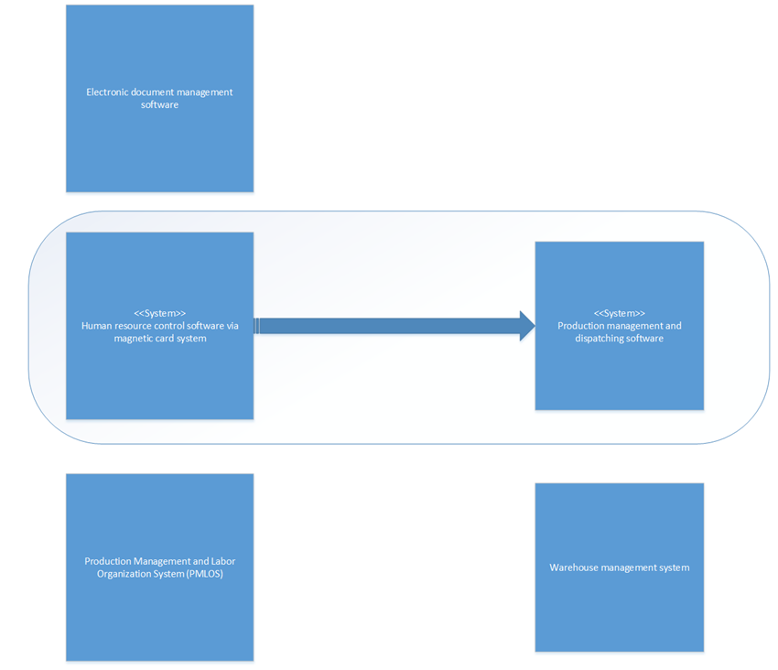
- Context diagram

Slide 53
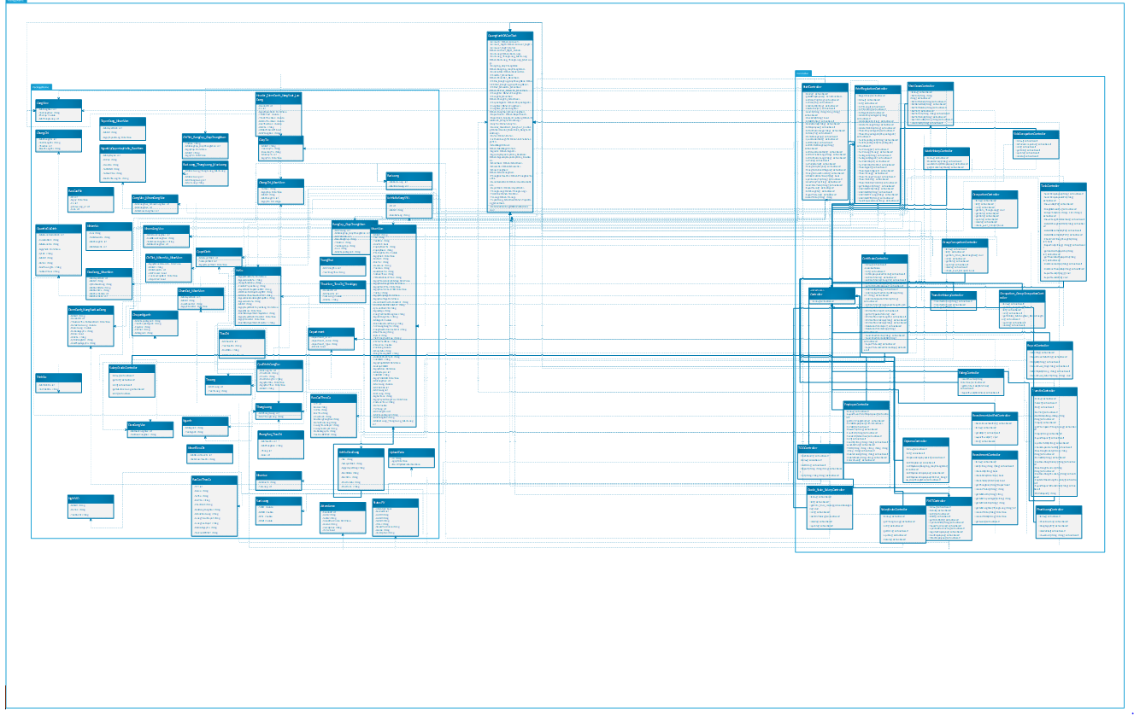
Class diagram

Slide 54
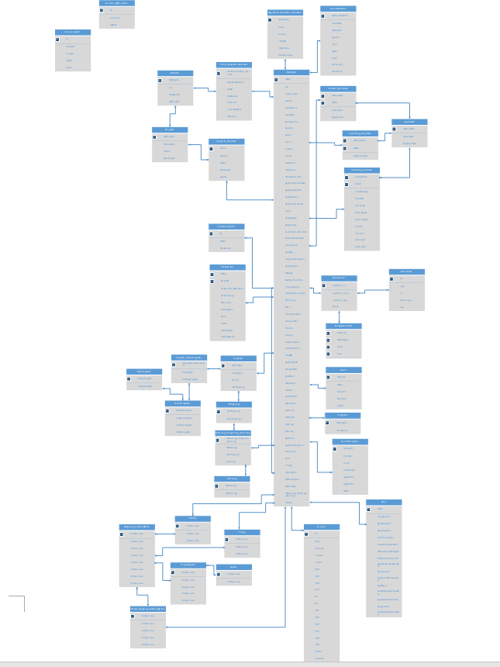
- Entity Relationship diagram

Slide 55
7. Testing
7.1. Tool
Purpose | Tool | Vendor/In-house | Version
UNIT Test | MS Visual Studio |  | 2015
User Interface Test | Chrome |  | 63.0.3239
Data and Database Integrity Testing | MS SQL Server |  | 2008, 2017

Slide 56
7.2. Human Resource
This table shows the staffing assumptions for the project.
Worker/Doer | Specific Responsibilities/Comments
VyPD | Manage Test resource and assign test tasks Create Test plan, test design , test case Excute test
ThuongVN | Review test plan Review test result Excute test Report test result
HuongNT | Excute test Report test result
HoangND | Excute test Report test result
LuatGM | Create test case Excute test Report test result

Slide 57
7.3. Functional Testing
7.3.1. Function Testing
Test Objective: | Ensure proper target-of-test functionality, including navigation, data entry, processing, and retrieval.
Technique: | Execute each use case, use-case flow, or function, using valid and invalid data, to verify the following: - The expected results occur when valid data is used. - The appropriate error or warning messages are displayed when invalid data is used. - Each business rule is properly applied.
Completion Criteria: | - All planned tests have been executed. - All identified defects have been addressed.
Special Considerations: | Identify or describe those items or issues (internal or external) that impact the implementation and execution of function test

Slide 58
7.3.2. User Interface Testing
Test Objective: | Verify the following: - Navigation through the target-of-test properly reflects business functions and requirements, including window-to-window, field-to-field, and use of access methods (tab keys, mouse movements, accelerator keys) - Window objects and characteristics, such as menus, size, position, state, and focus conform to standards.
Technique: | Create or modify tests for each window to verify proper navigation and object states for each application window and objects.
Completion Criteria: | Each window successfully verified to remain consistent with benchmark version or within acceptable standard
Special Considerations: | Not all properties for custom and third party objects can be accessed.

Slide 59
7.3.3. Data and Database Integrity Testing
Test Objective: | Ensure database access methods and processes function properly and without data corruption.
Technique: | - Invoke each database access method and process, seeding each with valid and invalid data or requests for data. - Inspect the database to ensure the data has been populated as intended, all database events occurred properly, or review the returned data to ensure that the correct data was retrieved for the correct reasons
Completion Criteria: | All database access methods and processes function as designed and without any data corruption.
Special Considerations: | - Testing may require a DBMS development environment or drivers to enter or modify data directly in the databases. - Processes should be invoked manually. - Small or minimally sized databases (limited number of records) should be used to increase the visibility of any non-acceptable events.

Slide 60
7.4. Performance testing
7.4.1. Performance Profiling
Test Objective: | Verify performance behaviors for designated transactions or business functions under the following conditions: • normal anticipated workload • anticipated worst case workload
Technique: | • Use Test Procedures developed for Function or Business Cycle Testing. • Modify data files to increase the number of transactions or the scripts to increase the number of iterations each transaction occurs. • Scripts should be run on one machine (best case to benchmark single user, single transaction) and be repeated with multiple clients (virtual or actual, see Special Considerations below).
Completion Criteria: | • Single Transaction or single user: Successful completion of the test scripts without any failures and within the expected or required time allocation per transaction. • Multiple transactions or multiple users: Successful completion of the test scripts without any failures and within acceptable time allocation.
Special Considerations: | Comprehensive performance testing includes having a background workload on the server. There are several methods that can be used to perform this, including: • “Drive transactions” directly to the server, usually in the form of Structured Query Language (SQL) calls. • Create “virtual” user load to simulate many clients, usually several hundred. Remote Terminal Emulation tools are used to accomplish this load. This technique can also be used to load the network with “traffic”. • Use multiple physical clients, each running test scripts to place a load on the system. Performance testing should be performed on a dedicated machine or at a dedicated time. This permits full control and accurate measurement. The databases used for Performance Testing should be either actual size or scaled equally.

Slide 61
7.4.2. Performance testing
Test Objective: | Verify that the target-of-test functions properly and without error under the following stress conditions: • little or no memory available on the server (RAM and DASD) • maximum actual or physically capable number of clients connected or simulated • multiple users performing the same transactions against the same data or accounts • worst-case transaction volume or mix (see Performance Testing above). Notes: The goal of Stress Testing might also be stated as identify and document the conditions under which the system FAILS to continue functioning properly.
Technique: | • Use tests developed for Performance Profiling or Load Testing. • To test limited resources, tests should be run on a single machine, and RAM and DASD on server should be reduced or limited. • For remaining stress tests, multiple clients should be used, either running the same tests or complementary tests to produce the worst-case transaction volume or mix.
Completion Criteria: | All planned tests are executed and specified system limits are reached or exceeded without the software failing or conditions under which system failure occurs is outside of the specified conditions.
Special Considerations: | • Stressing the network may require network tools to load the network with messages or packets. • The DASD used for the system should temporarily be reduced to restrict the available space for the database to grow. • Synchronization of the simultaneous clients accessing of the same records or data accounts.

Slide 62
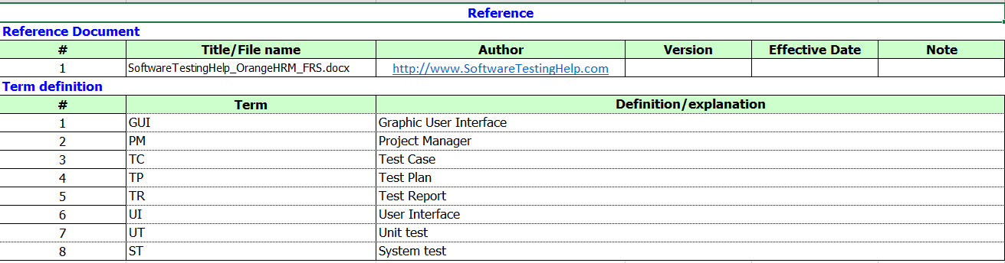
7.5. Test Design

Slide 63
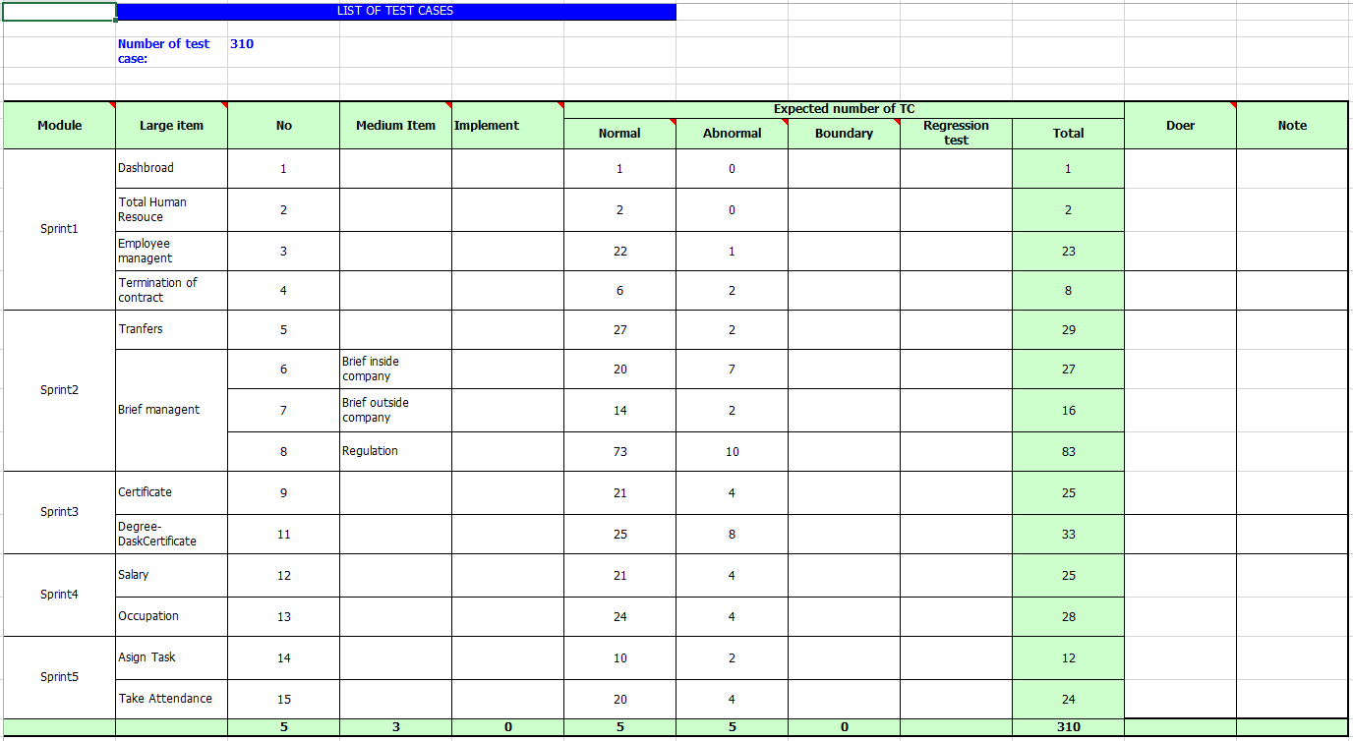

Slide 64
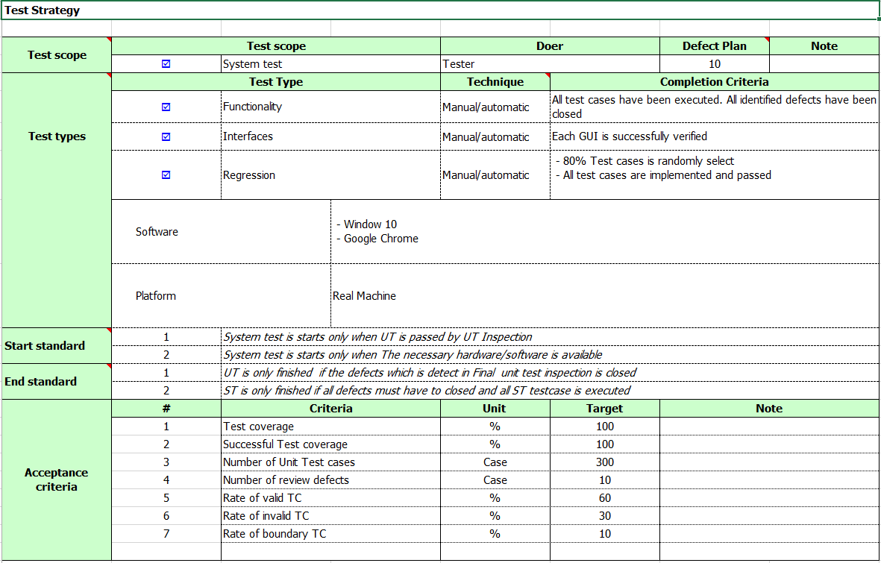

Slide 65
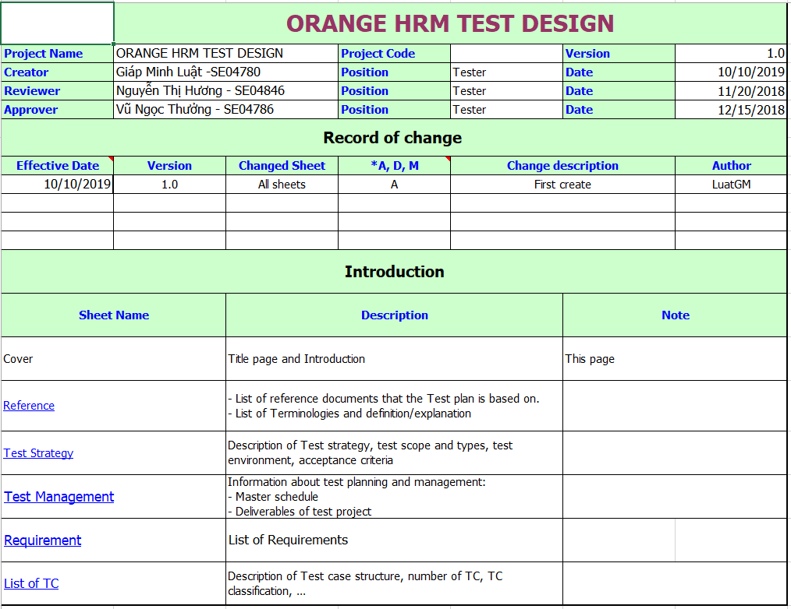

Slide 66
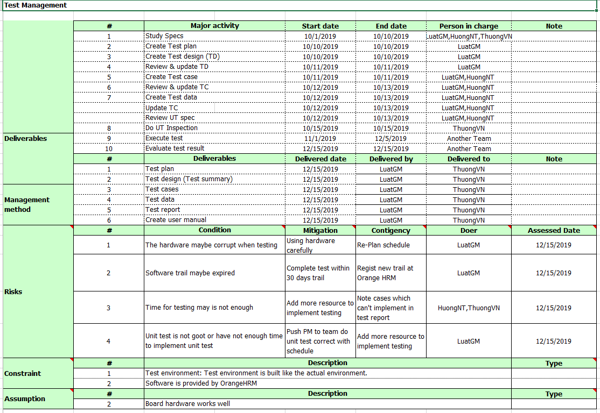

Slide 67
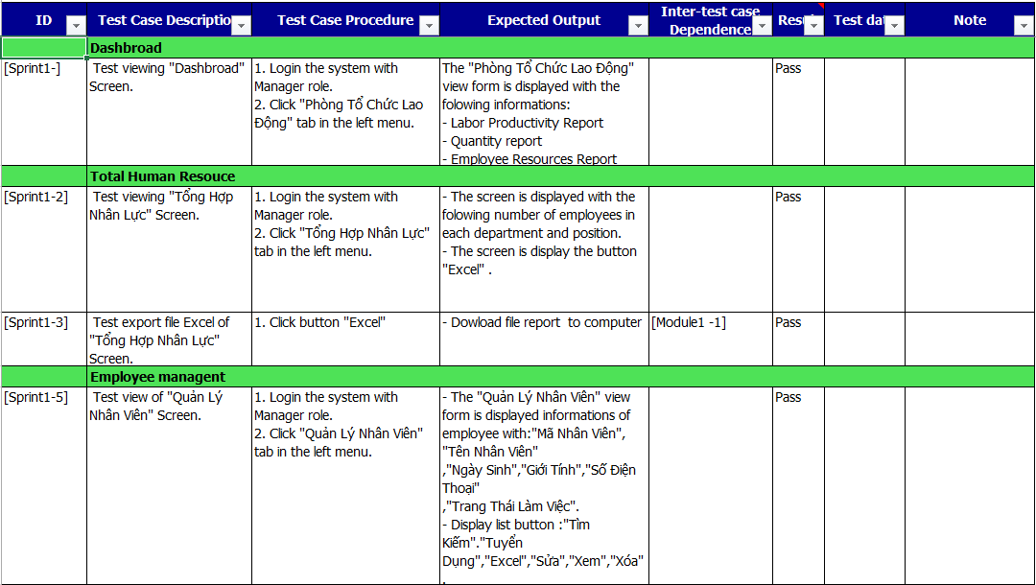
7.6. Test case sample

Slide 68
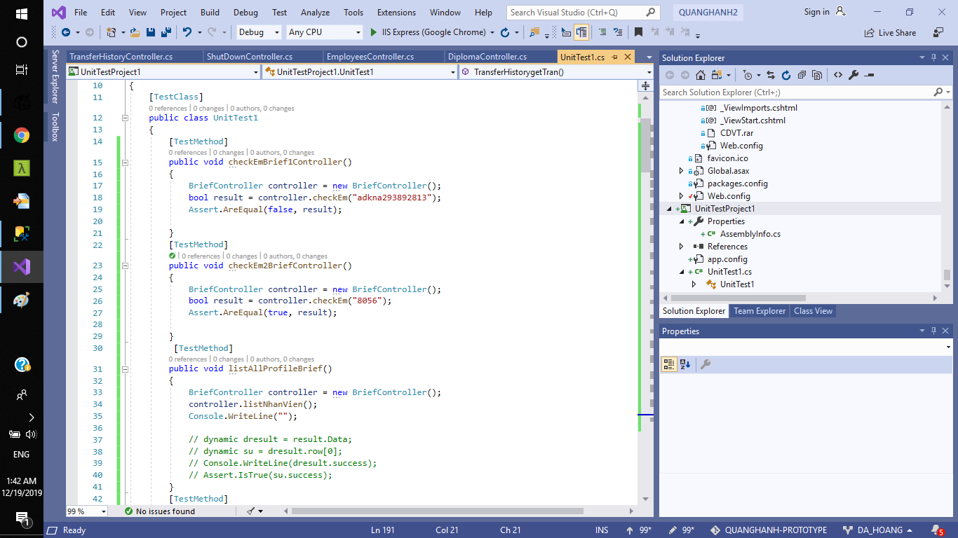
7.7. Unit test sample

Slide 69
Demo & QA

